Slide 1
ECE 884 Deep Learning
Lecture 21: Autoencoder
04/13/2021

Slide 2
Review of last lecture
Attention without RNN
Self-Attention without RNN
Transformer Model

Slide 3
Today’s lecture
Autoregressive Model
Autoencoder
Variational Autoencoder
Notes:
To add:
Weight initialization
Batch normalization

Slide 4
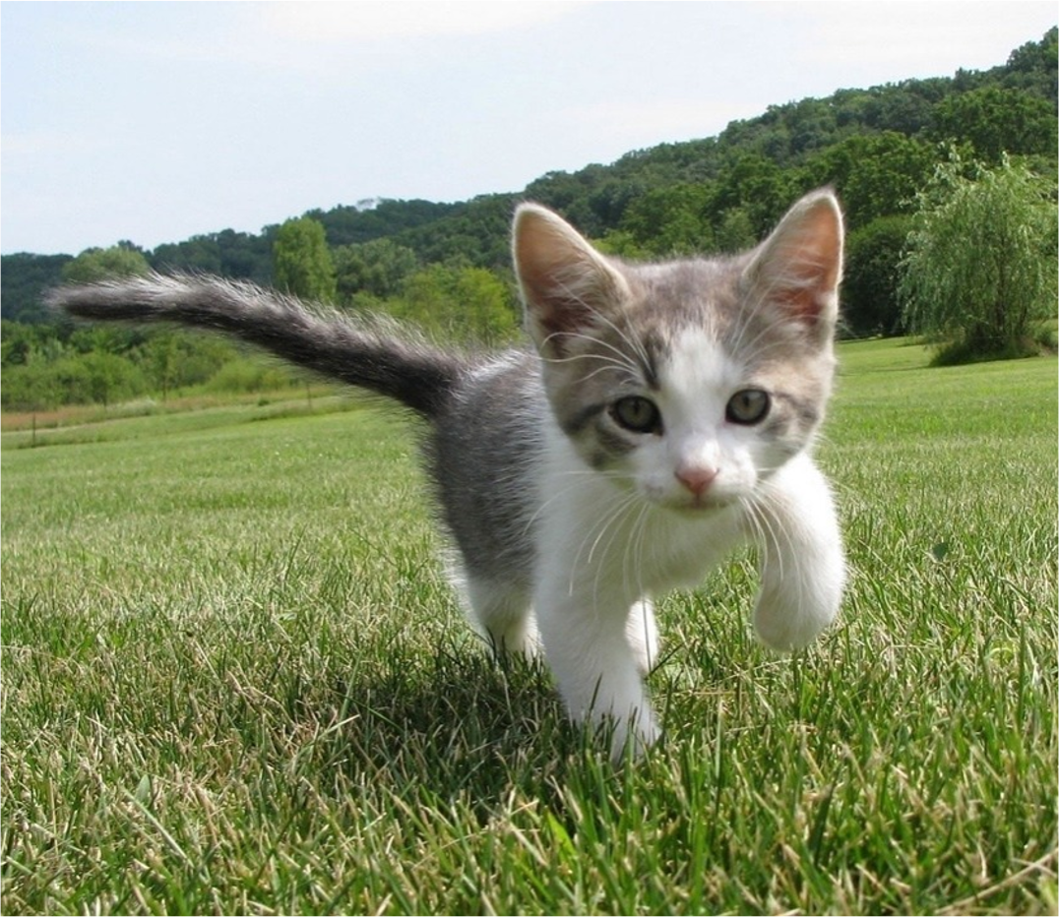
Supervised vs Unsupervised Learning
Supervised Learning
Classification
Data: (x, y)
x is data, y is label
Goal: Learn a function to map x -> y
Examples: Classification, regression, object detection, semantic segmentation, image captioning, etc.
Cat
This image is CC0 public domain

Slide 5
Supervised vs Unsupervised Learning
Supervised Learning Unsupervised Learning
Data: (x, y)
x is data, y is label
Data: x
Just data, no labels!
Goal: Learn a function to map x -> y
Goal: Learn some underlying hidden structure of the data
Examples: Classification, regression, object detection, semantic segmentation, image captioning, etc.
Examples: Clustering, dimensionality reduction, feature learning, density estimation, etc.

Slide 6
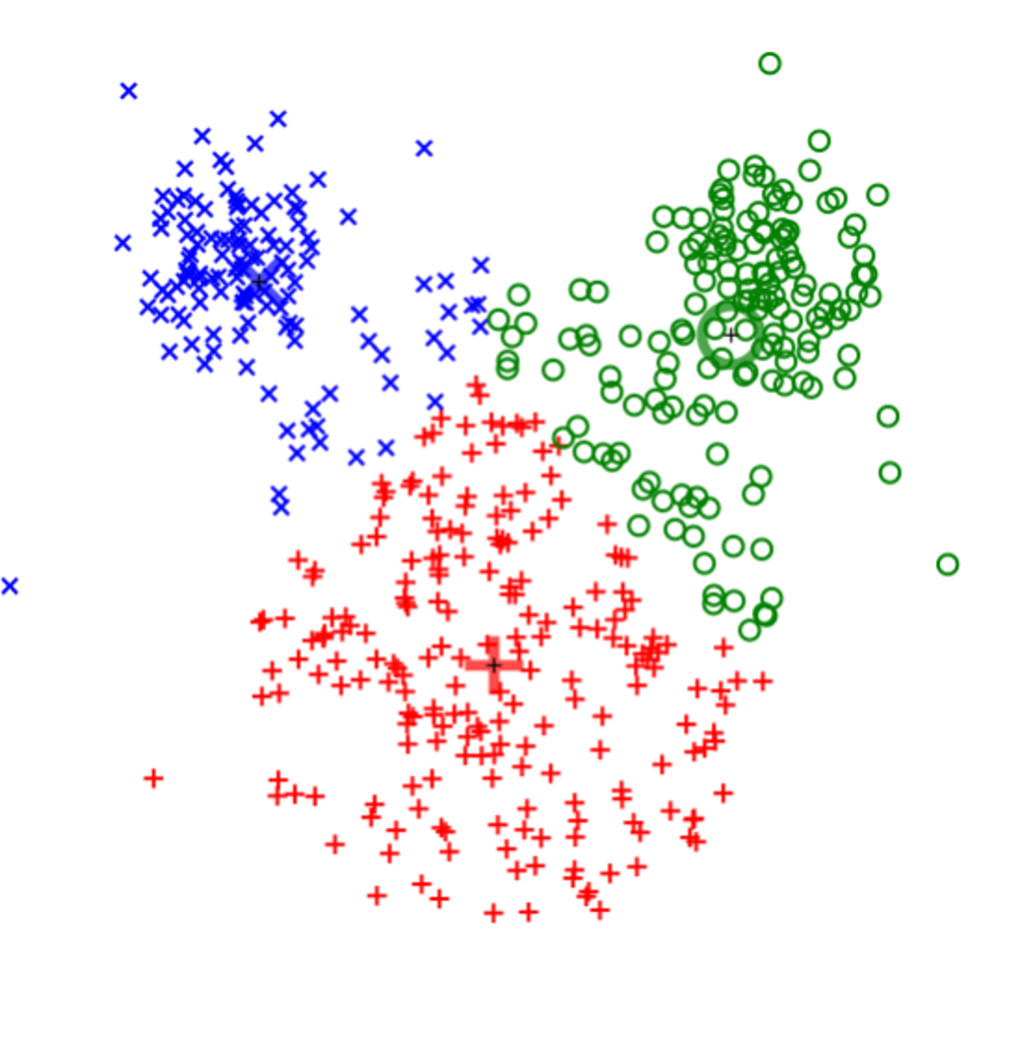
Supervised vs Unsupervised Learning
Clustering (e.g. K-Means)
Unsupervised Learning
Data: x
Just data, no labels!
Goal: Learn some underlying hidden structure of the data
Examples: Clustering,
dimensionality reduction, feature learning, density estimation, etc.
This image is CC0 public domain

Slide 7
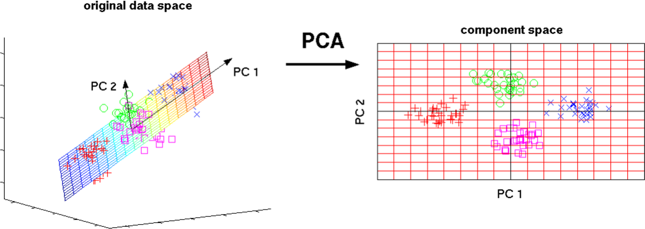
Supervised vs Unsupervised Learning
Unsupervised Learning
Dimensionality Reduction
(e.g. Principal Components Analysis)
Data: x
Just data, no labels!
Goal: Learn some underlying hidden structure of the data
3D
2D
Examples: Clustering,
dimensionality reduction, feature learning, density estimation, etc.
This image from Matthias Scholz is CC0 public domain

Slide 8
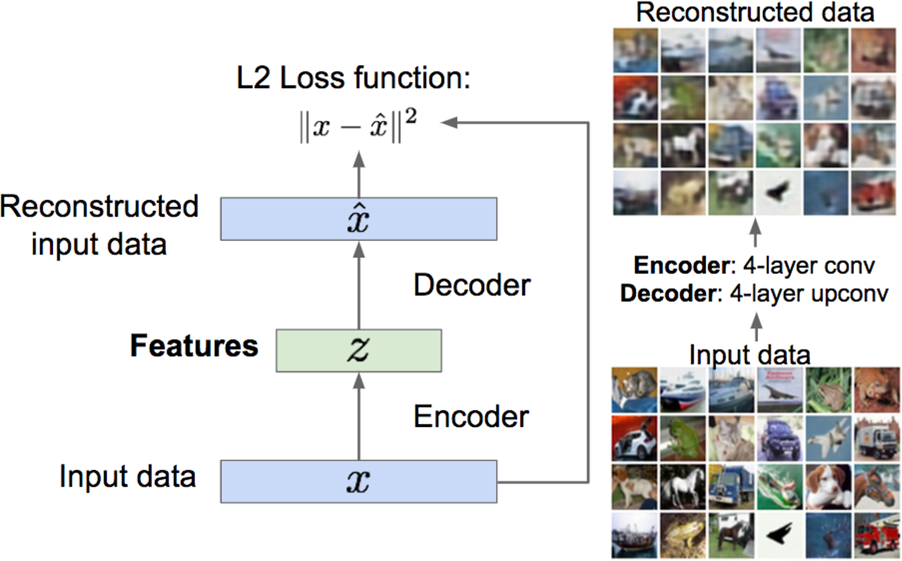
Supervised vs Unsupervised Learning
Feature Learning (e.g. autoencoders)
Unsupervised Learning
Data: x
Just data, no labels!
Goal: Learn some underlying hidden structure of the data
Examples: Clustering, dimensionality reduction, feature learning, density estimation, etc.

Slide 9
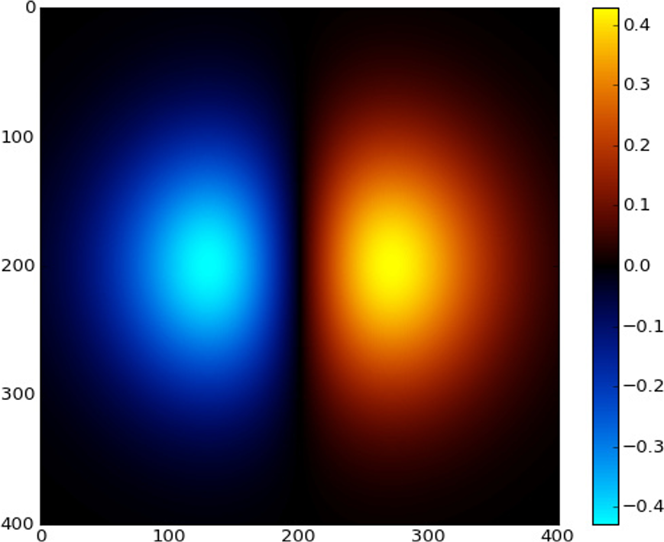
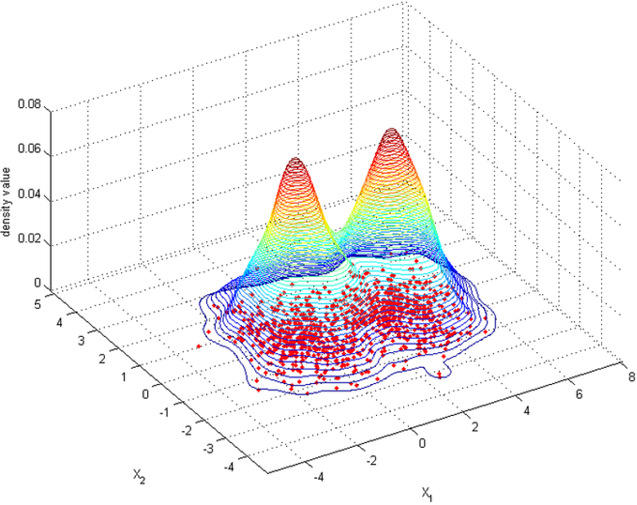
Supervised vs Unsupervised Learning
Unsupervised Learning
Density Estimation
Data: x
Just data, no labels!
Goal: Learn some underlying hidden structure of the data
Examples: Clustering, dimensionality reduction, feature learning, density estimation, etc.
Images left and right are CC0 public domain

Slide 10
Supervised vs Unsupervised Learning
Supervised Learning Unsupervised Learning
Data: (x, y)
x is data, y is label
Data: x
Just data, no labels!
Goal: Learn a function to map x -> y
Goal: Learn some underlying hidden structure of the data
Examples: Classification, regression, object detection, semantic segmentation, image captioning, etc.
Examples: Clustering, dimensionality reduction, feature learning, density estimation, etc.

Slide 11

Discriminative vs Generative Models
Discriminative Model: Learn a probability distribution p(y|x)
Data: x
Generative Model: Learn a probability distribution p(x)
Label: y
Cat
Conditional Generative Model: Learn p(x|y)

Slide 12
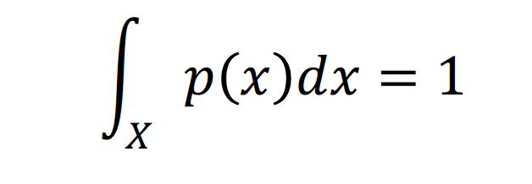
Discriminative vs Generative Models
Probability Recap:
Density Function
p(x) assigns a positive number to each possible x; higher numbers mean x is more likely
Density functions are
normalized:
Discriminative Model: Learn a probability distribution p(y|x)
Data: x
Generative Model: Learn a probability distribution p(x)
Label: y
Cat
Conditional Generative Model: Learn p(x|y)

Slide 13
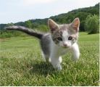
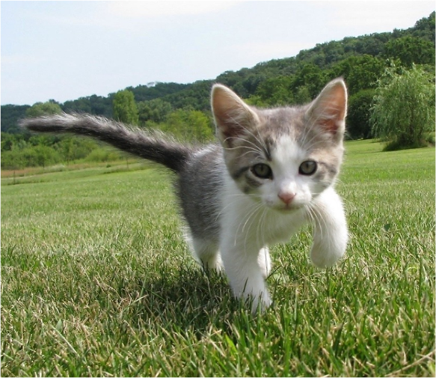
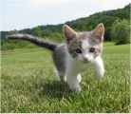
Discriminative vs Generative Models
P(cat|. )
P(dog|. )
Discriminative Model: Learn a probability distribution p(y|x)
Data: x
Generative Model: Learn a probability distribution p(x)
Conditional Generative Model: Learn p(x|y)
Density functions are normalized:
Density Function
p(x) assigns a positive number to each possible x; higher numbers mean x is more likely

Slide 14
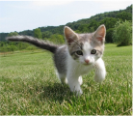
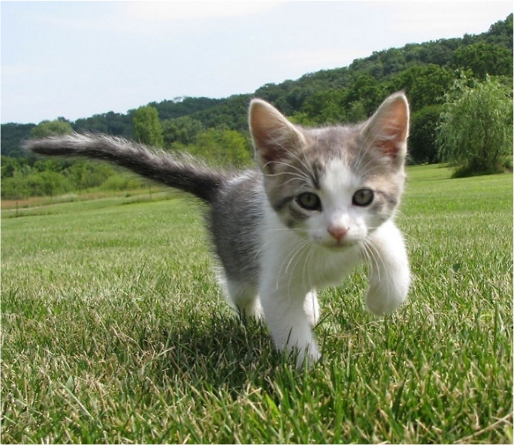
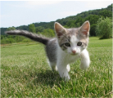
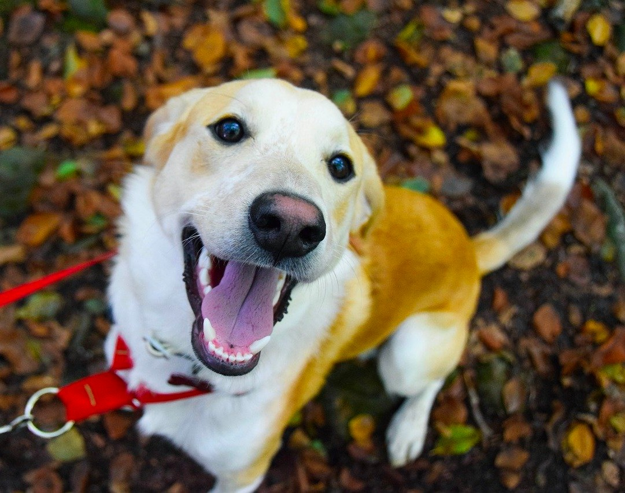
Discriminative vs Generative Models
P(cat|. )
Discriminative Model: Learn a probability distribution p(y|x)
P(dog|. )
Generative Model: Learn a probability distribution p(x)
P(dog| )
P(cat| )
Discriminative model: the possible labels for each input ”compete” for probability mass.
But no competition between images
Conditional Generative Model: Learn p(x|y)
Dog image is CC0 Public Domain

Slide 15
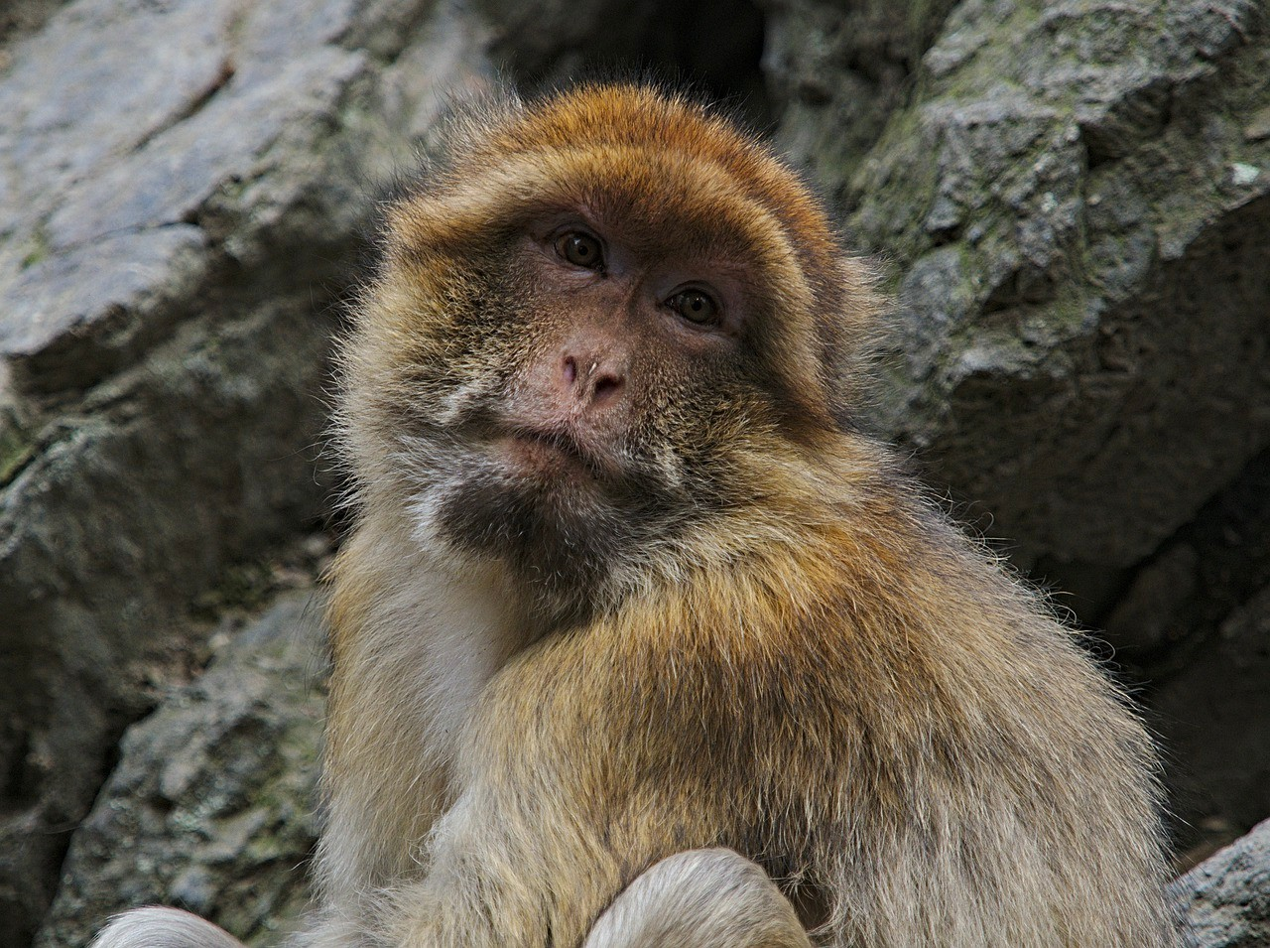
Discriminative vs Generative Models
Discriminative Model: Learn a probability distribution p(y|x)
P(cat| )
P(dog| )
Generative Model: Learn a probability distribution p(x)
P(dog| )
P(cat| )
Discriminative model: No way for the model to handle unreasonable inputs; it must give label distributions for all images
Conditional Generative Model: Learn p(x|y)
Monkey image is CC0 Public Domain

Slide 16
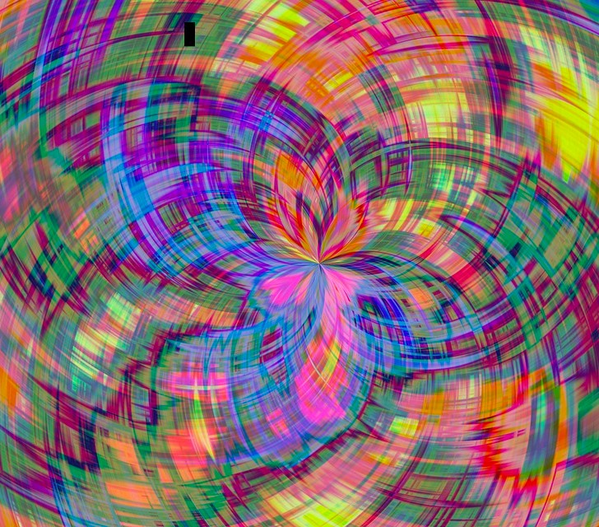
Discriminative vs Generative Models
Discriminative Model: Learn a probability distribution p(y|x)
P(cat| )
P(dog| )
Generative Model: Learn a probability distribution p(x)
P(dog| )
P(cat| )
Conditional Generative Model: Learn p(x|y)
Discriminative model: No way for the model to handle unreasonable inputs; it must give
label distributions for all images
Monkey image is CC0 Public Domain
Abstract image is free to use under the Pixabay license

Slide 17
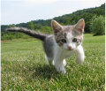
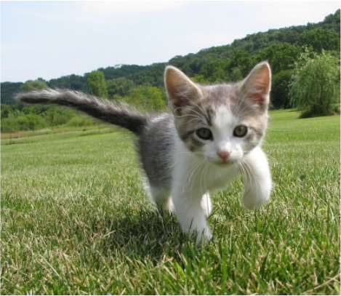
Discriminative vs Generative Models
P( )
Cat image is CC0 public domain Dog image is CC0 Public Domain
Monkey image is CC0 Public Domain
Abstract image is free to use under the Pixabay license
Discriminative Model: Learn a probability distribution p(y|x)
P( )
P( )
P( )
Generative Model: Learn a probability distribution p(x)
…
Generative model: All possible images compete with each other for probability mass
Conditional Generative Model: Learn p(x|y)

Slide 18
Discriminative vs Generative Models
P( )
Cat image is CC0 public domain Dog image is CC0 Public Domain
Monkey image is CC0 Public Domain
Abstract image is free to use under the Pixabay license
Discriminative Model: Learn a probability distribution p(y|x)
P( )
P( )
P( )
Generative Model: Learn a probability distribution p(x)
…
Generative model: All possible images compete with each other for probability mass
Conditional Generative Model: Learn p(x|y)
Requires deep image understanding! Is a dog more likely to sit or stand? How about 3-legged dog vs 3-armed monkey?

Slide 19
Discriminative vs Generative Models
P( )
Cat image is CC0 public domain Dog image is CC0 Public Domain
Monkey image is CC0 Public Domain
Abstract image is free to use under the Pixabay license
Discriminative Model: Learn a probability distribution p(y|x)
P( )
P( )
P( )
Generative Model: Learn a probability distribution p(x)
…
Generative model: All possible images compete with each other for probability mass
Conditional Generative Model: Learn p(x|y)
Model can “reject” unreasonable inputs by assigning them small values

Slide 20

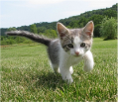

Discriminative vs Generative Models
P( |cat)
Cat image is CC0 public domain Dog image is CC0 Public Domain
Monkey image is CC0 Public Domain
Abstract image is free to use under the Pixabay license
Discriminative Model: Learn a probability distribution p(y|x)
P( |cat)
P( |dog)
P( |cat)
P( |cat)
P( |dog)
P( |dog)
P( |dog)
Generative Model: Learn a probability distribution p(x)
…
Conditional Generative Model: Learn p(x|y)
Conditional Generative Model: Each possible label induces a competition among all images

Slide 21
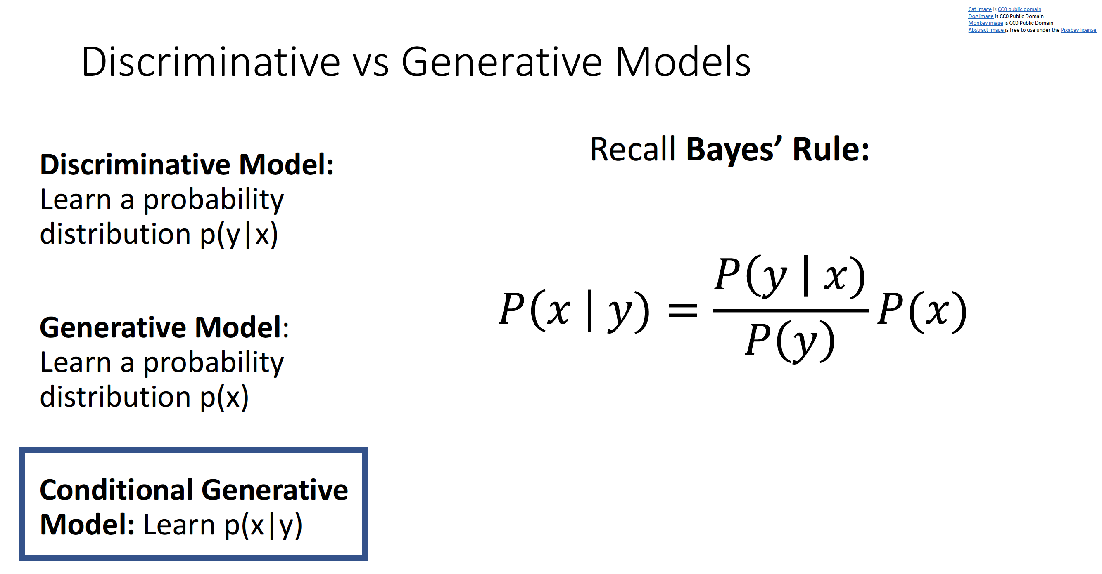

Slide 22
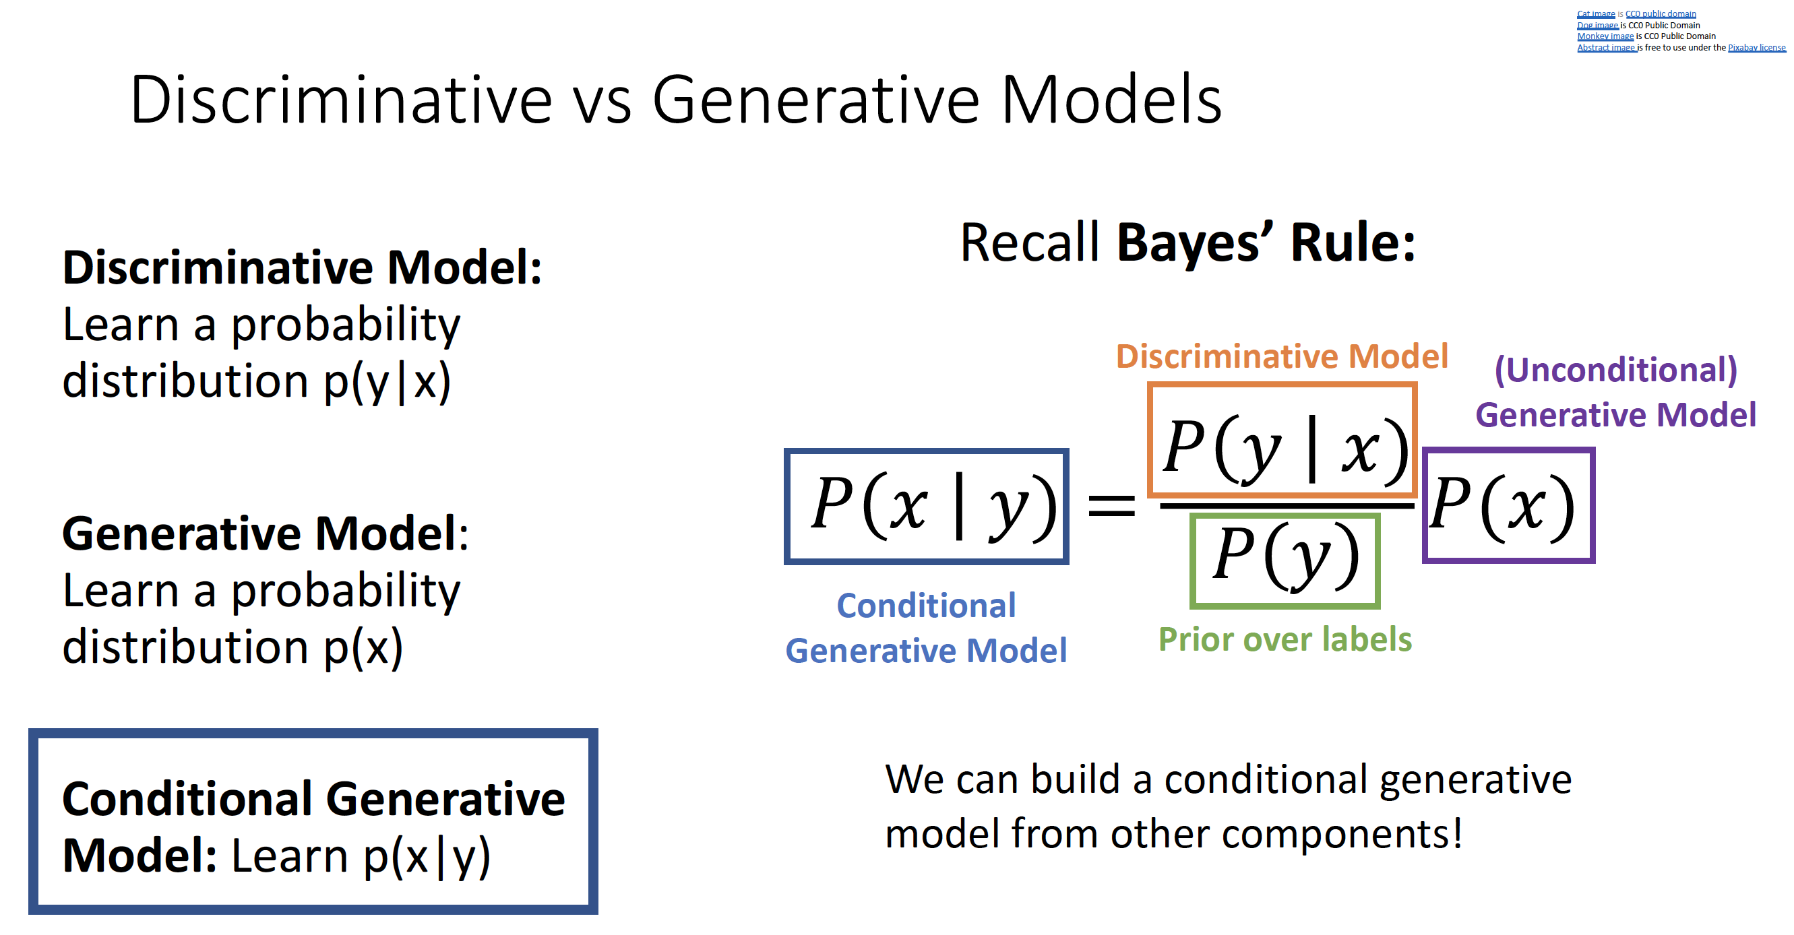

Slide 23
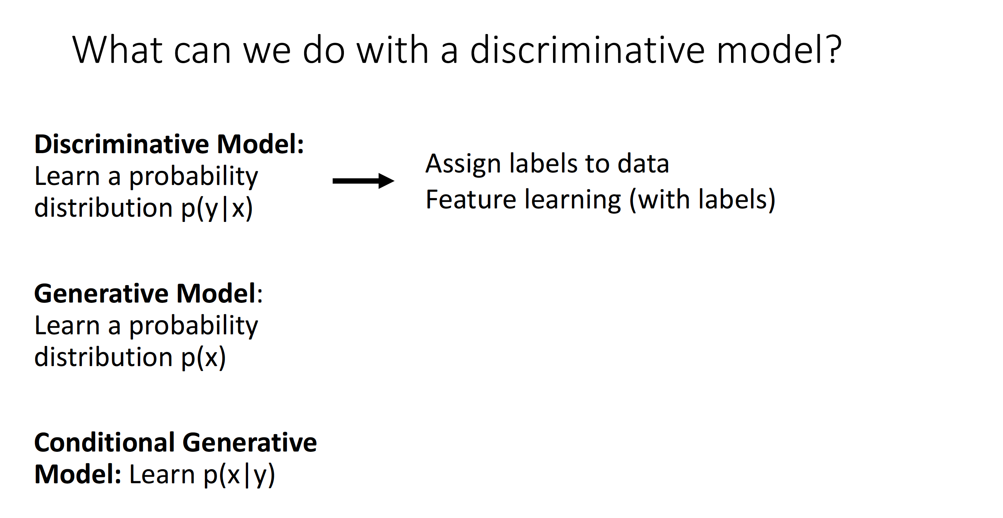

Slide 24
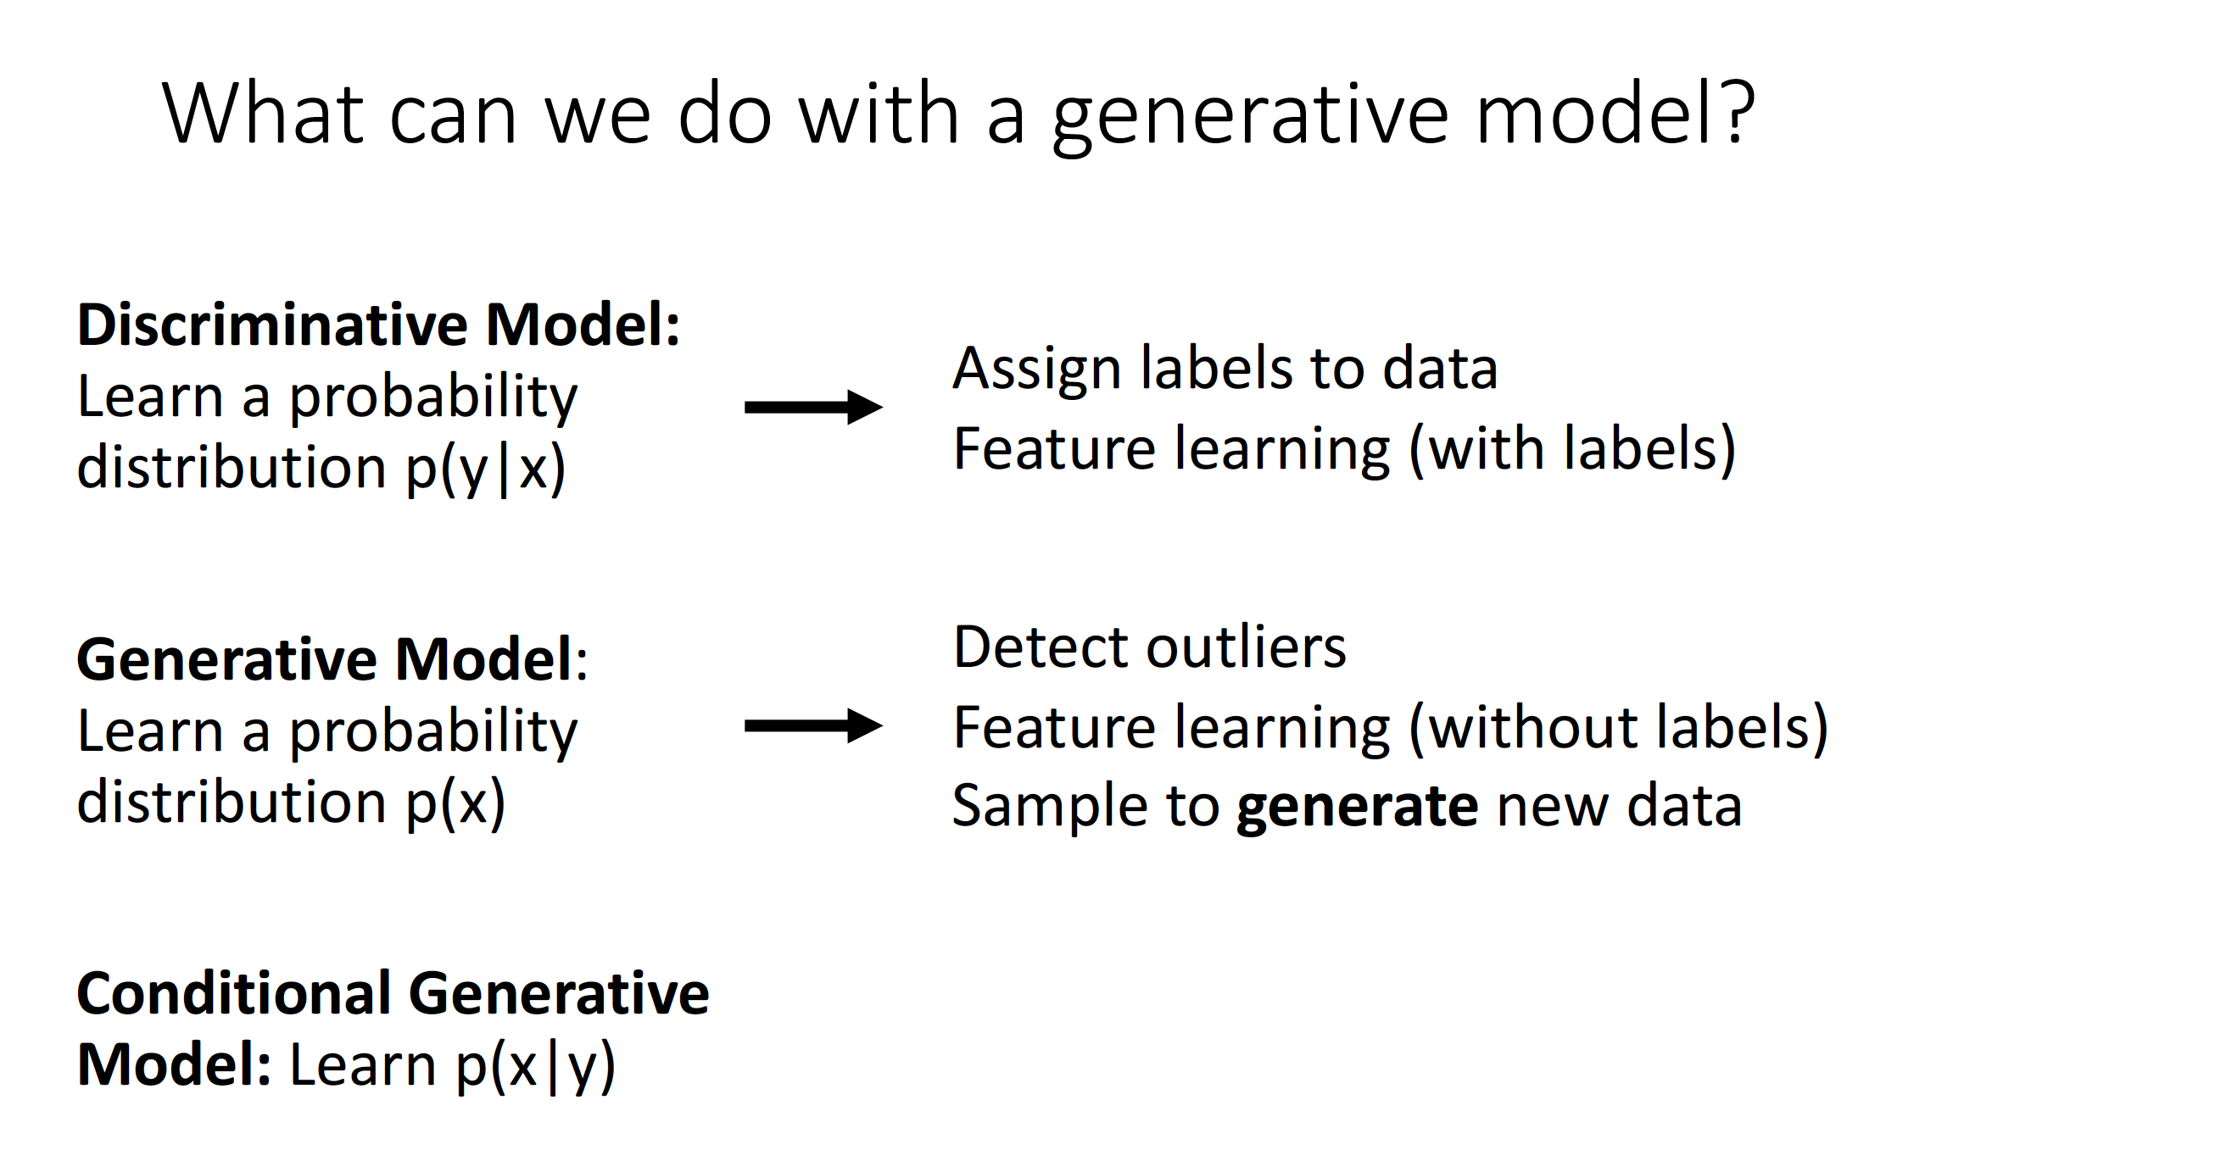

Slide 25
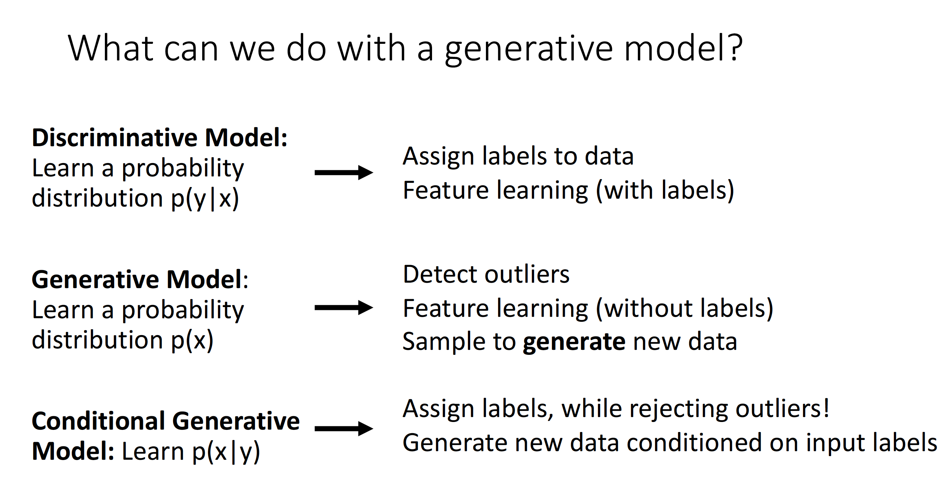

Slide 26
Taxonomy of Generative Models
Model does not explicitly compute p(x), but can sample from p(x)
Model can compute p(x)
Generative models
Explicit density
Implicit density
Can compute approximation to p(x)
Tractable density
Approximate density
Markov Chain
Direct
Can compute p(x)
GSN
Generative Adversarial Networks (GANs)
Autoregressive
NADE / MADE
NICE / RealNVP
Glow
Ffjord
Variational
Markov Chain
Variational Autoencoder
Boltzmann Machine
Figure adapted from Ian Goodfellow, Tutorial on Generative Adversarial Networks, 2017.

Slide 27
Taxonomy of Generative Models
Model does not explicitly compute p(x), but can sample from p(x)
Model can compute p(x)
Generative models
Explicit density
Implicit density
Can compute approximation to p(x)
Tractable density
Approximate density
Markov Chain
Direct
Can compute p(x)
GSN
Generative Adversarial Networks (GANs)
Autoregressive
NADE / MADE
NICE / RealNVP
Glow
Ffjord
Variational
Markov Chain
We will talk about these
Variational Autoencoder
Boltzmann Machine
Figure adapted from Ian Goodfellow, Tutorial on Generative Adversarial Networks, 2017.

Slide 28
Autoregressive models

Slide 29
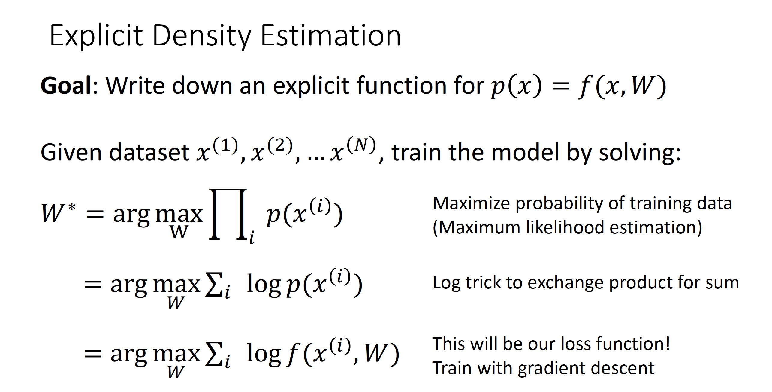

Slide 30
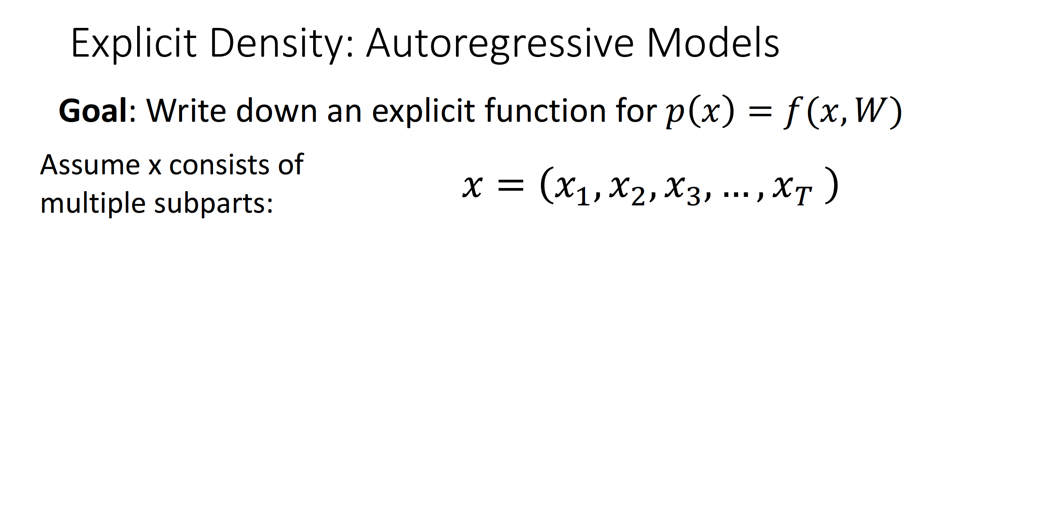

Slide 31
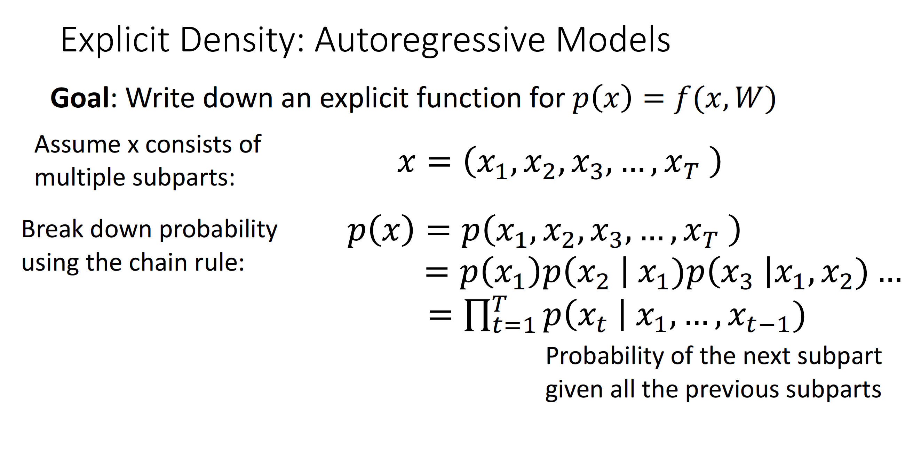

Slide 32
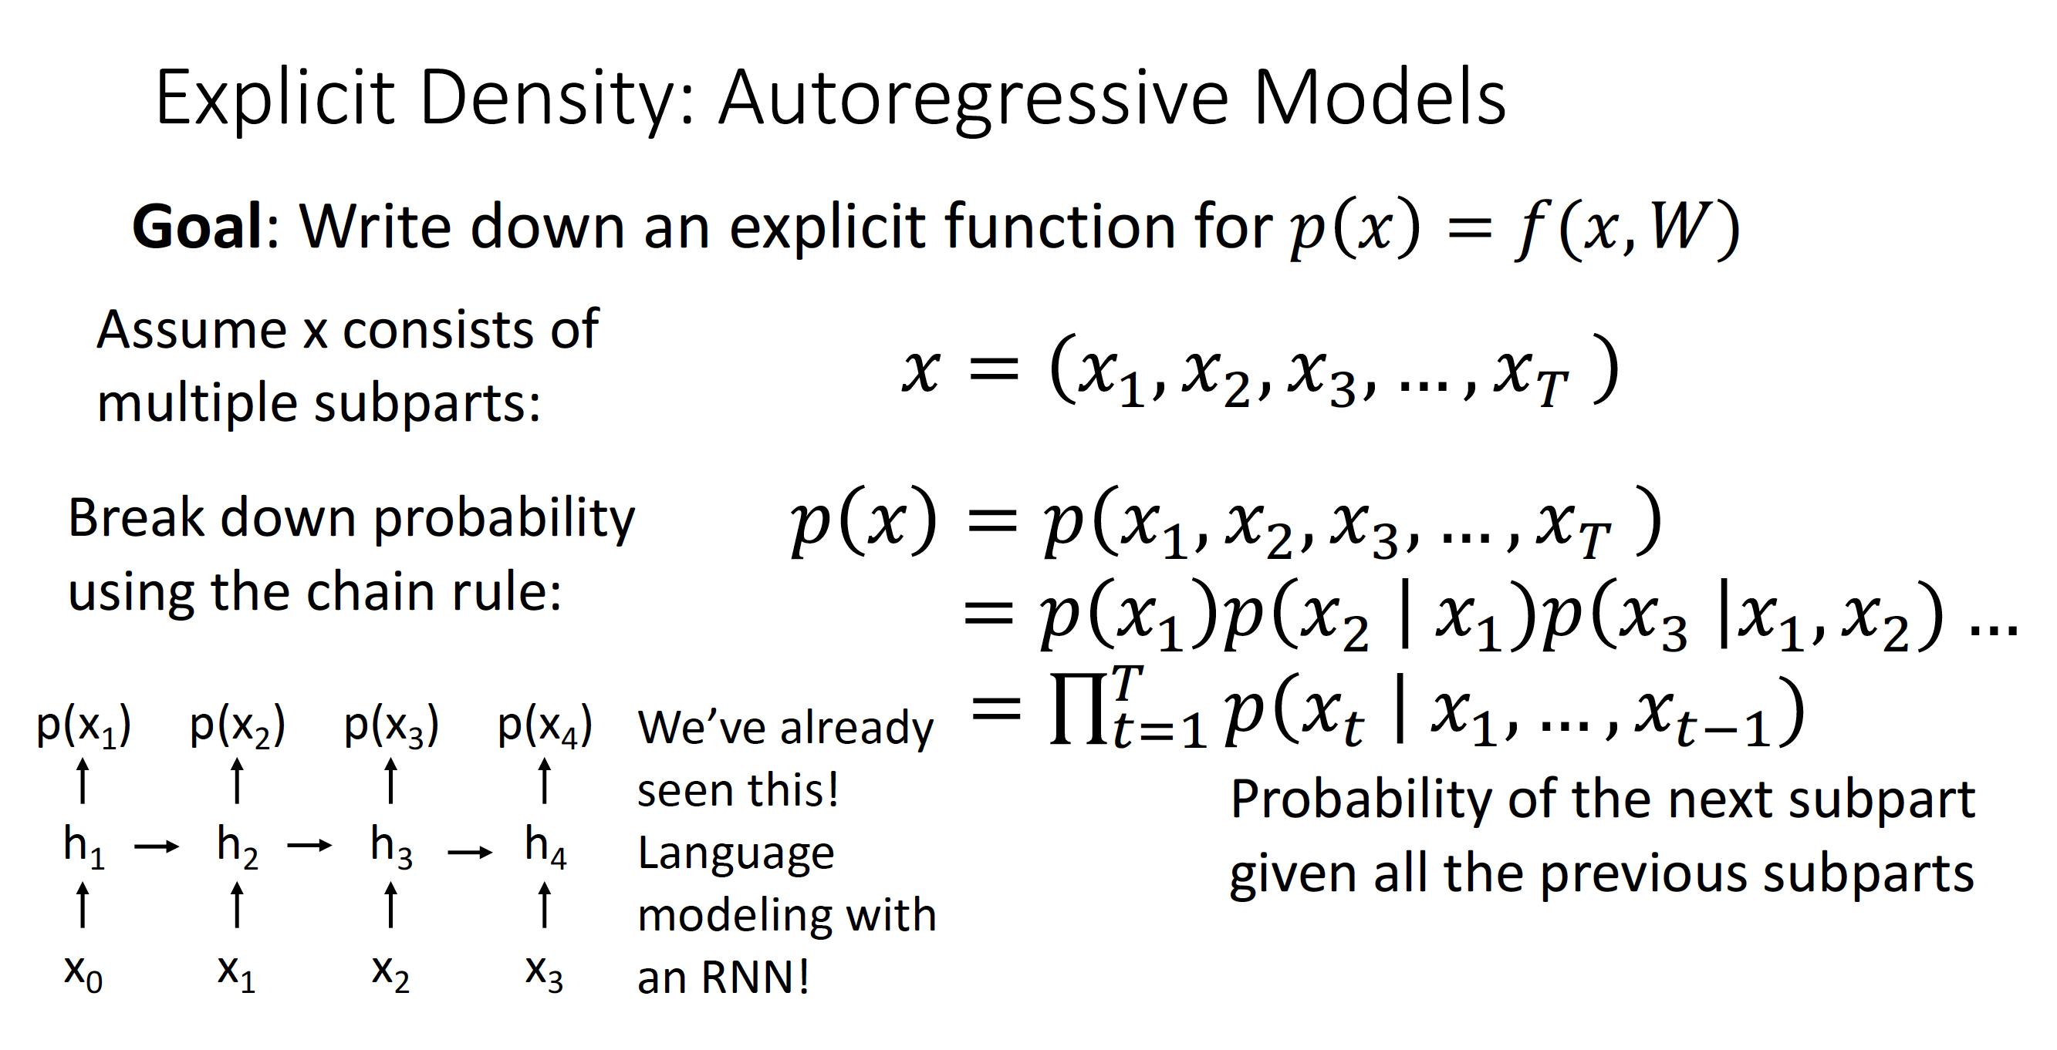

Slide 33
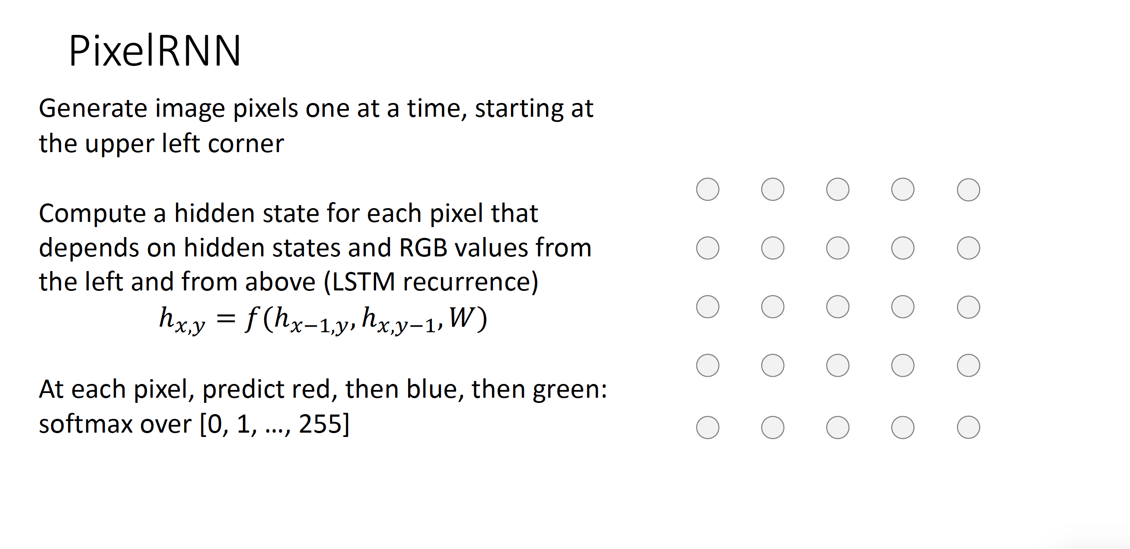

Slide 34
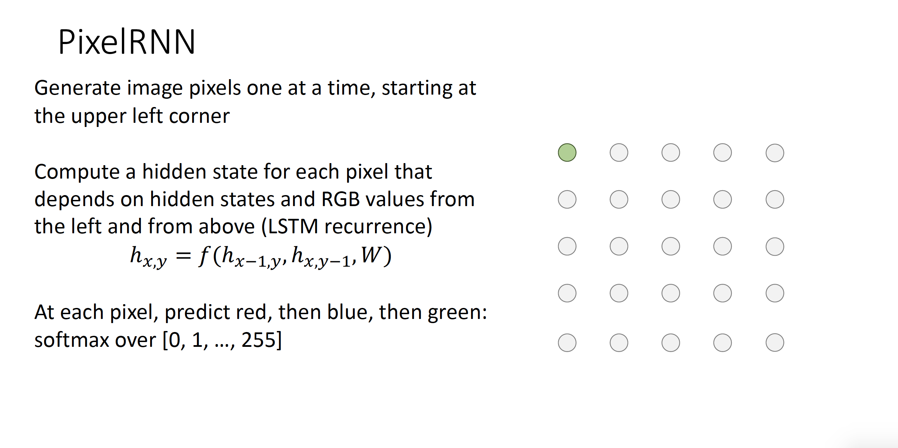

Slide 35
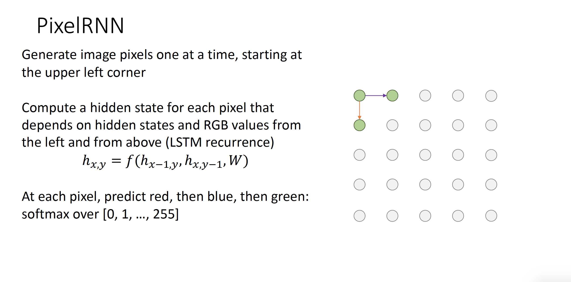

Slide 36
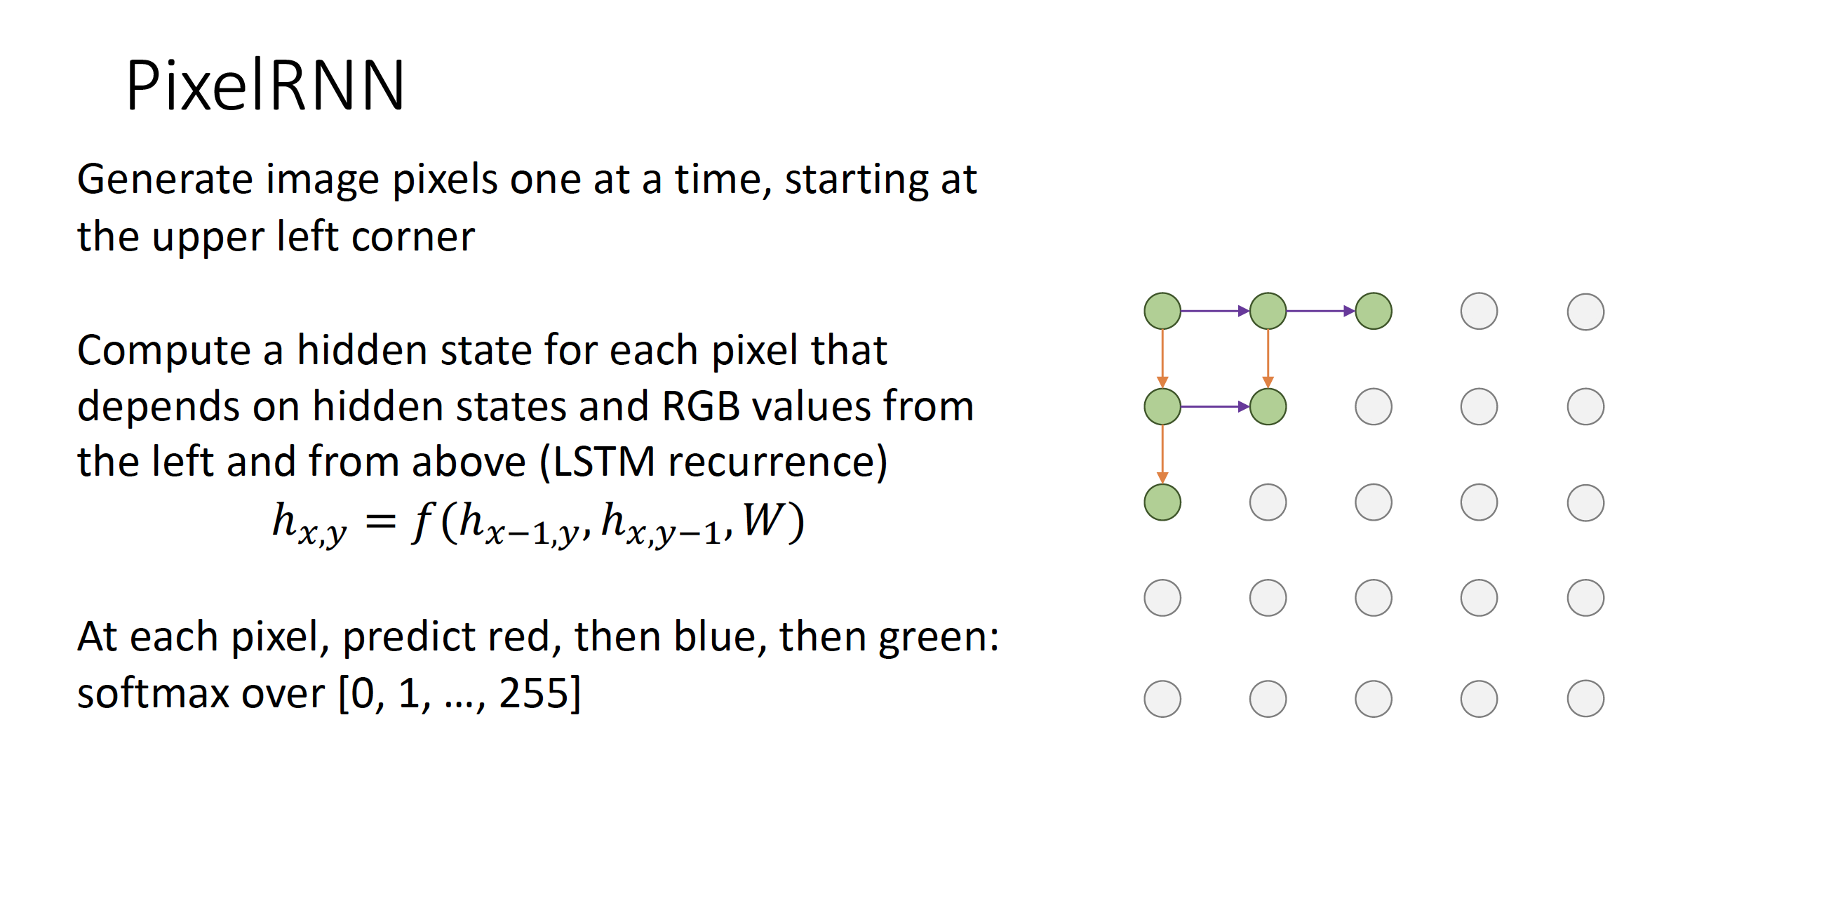

Slide 37
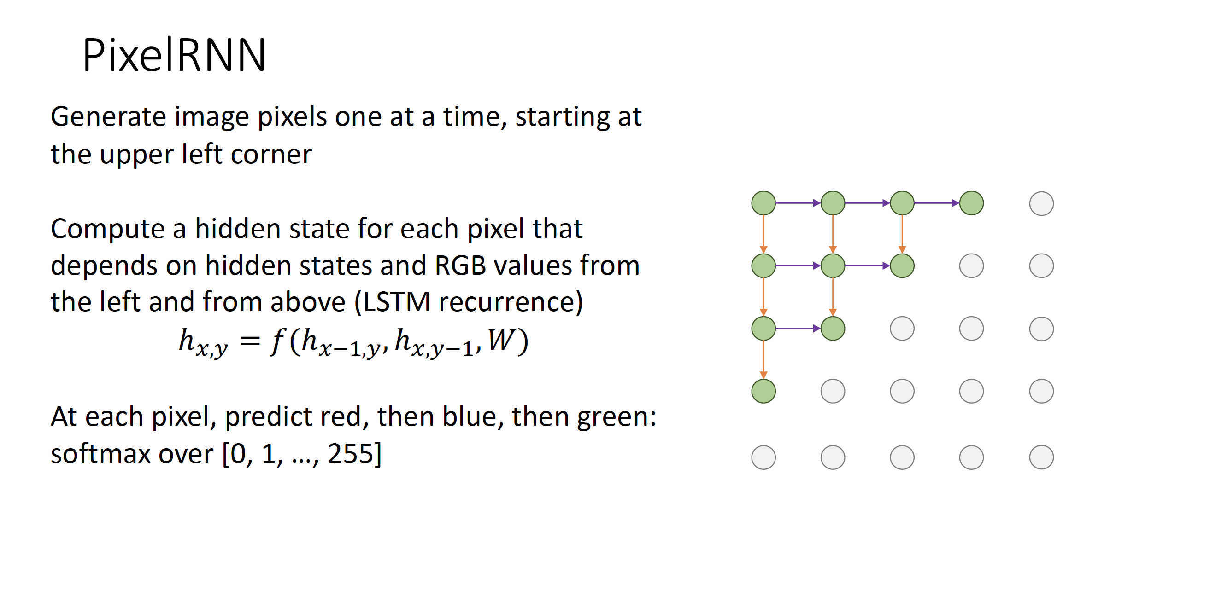

Slide 38
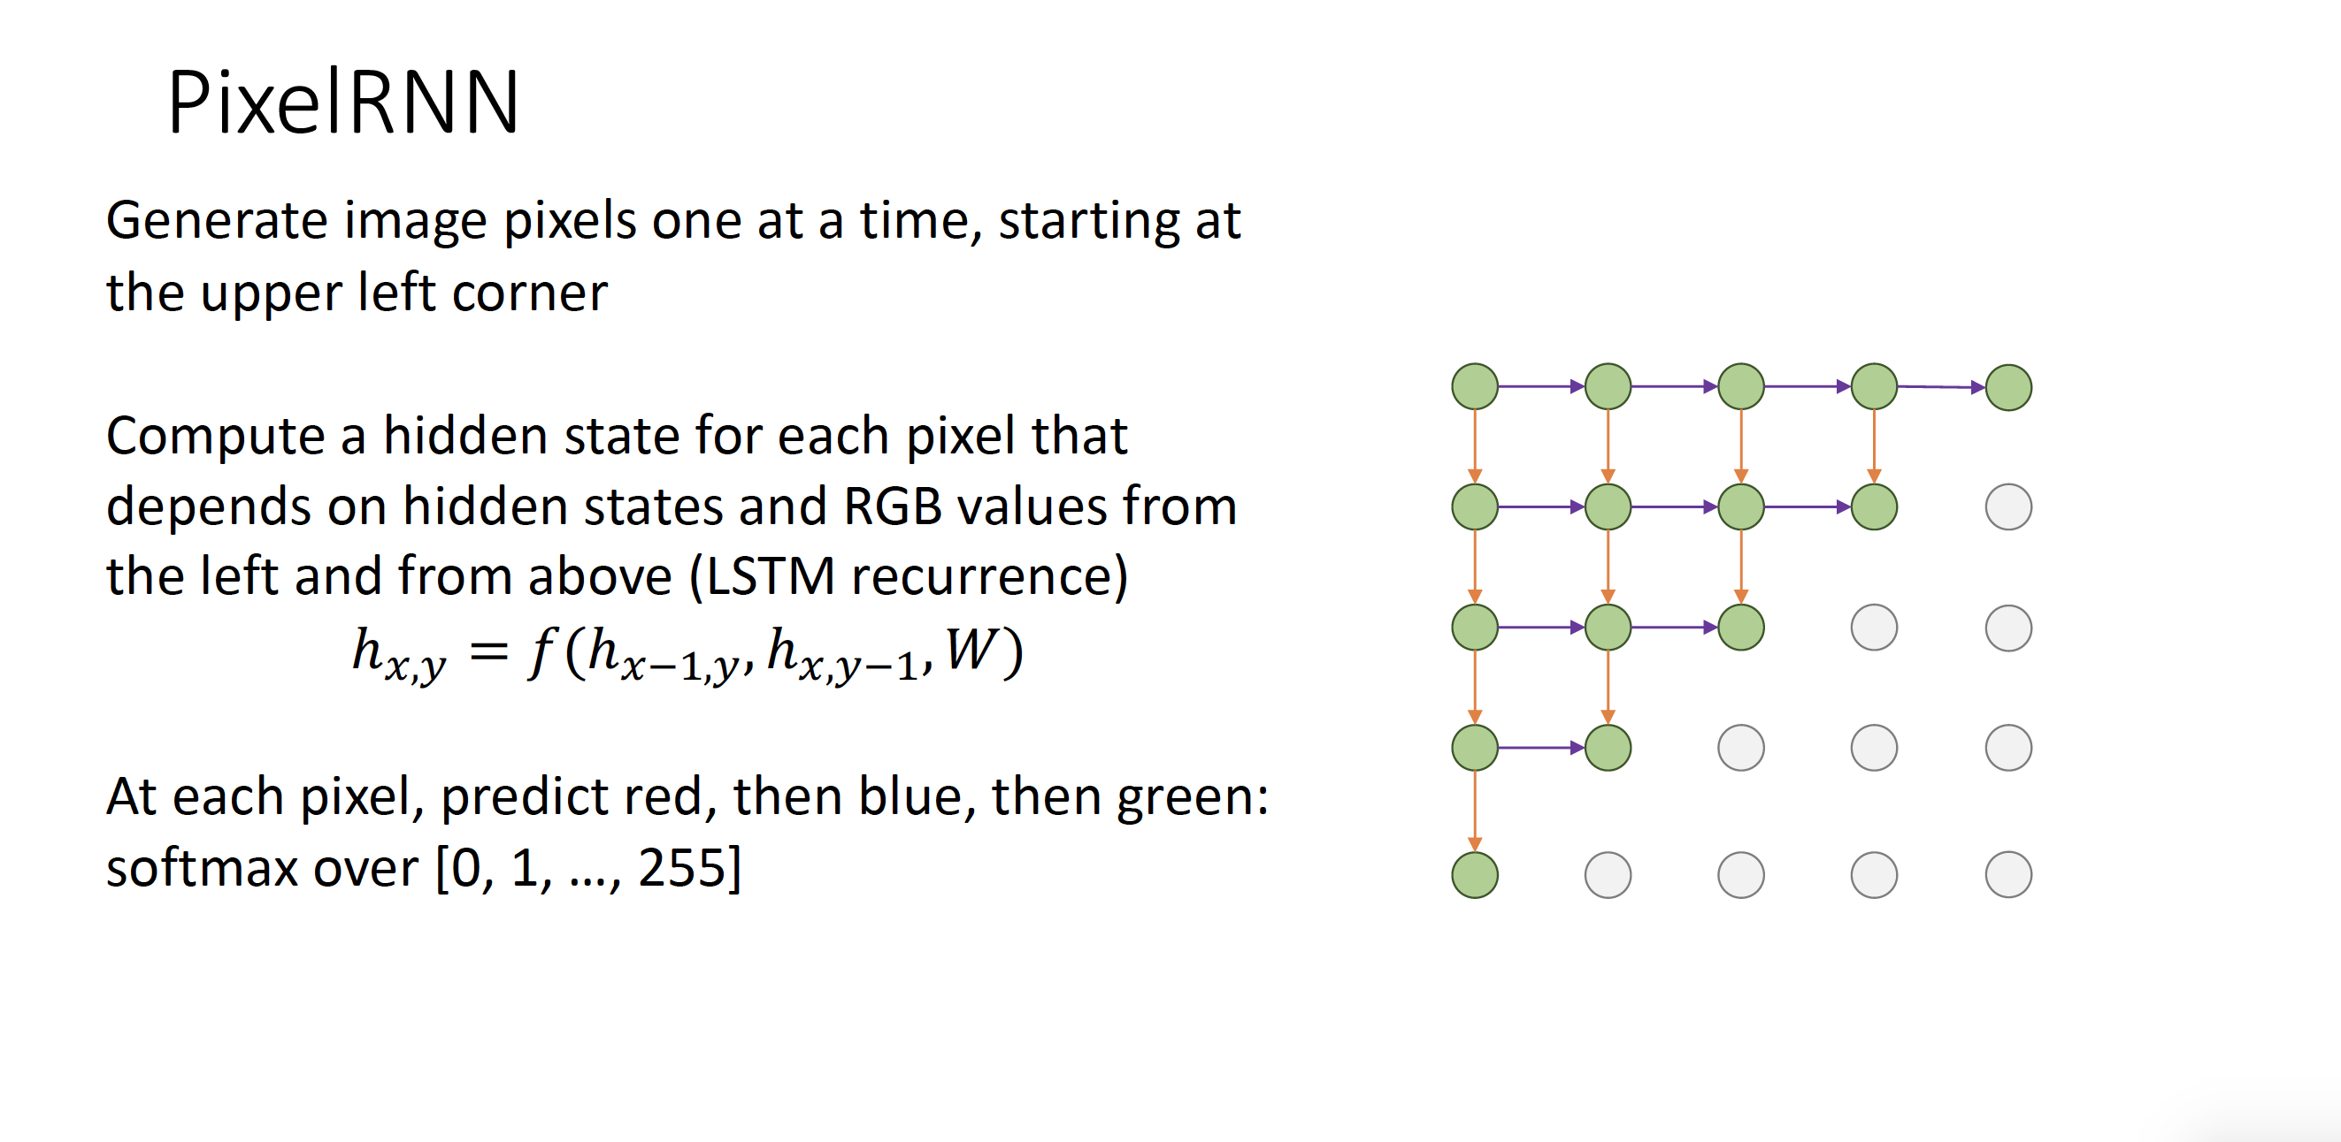

Slide 39
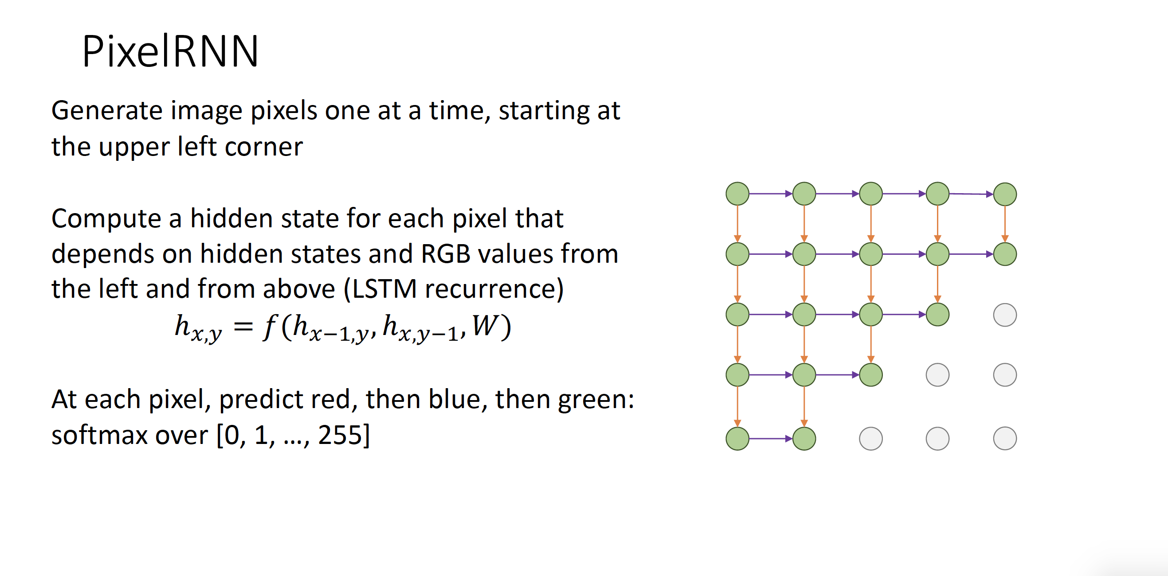

Slide 40
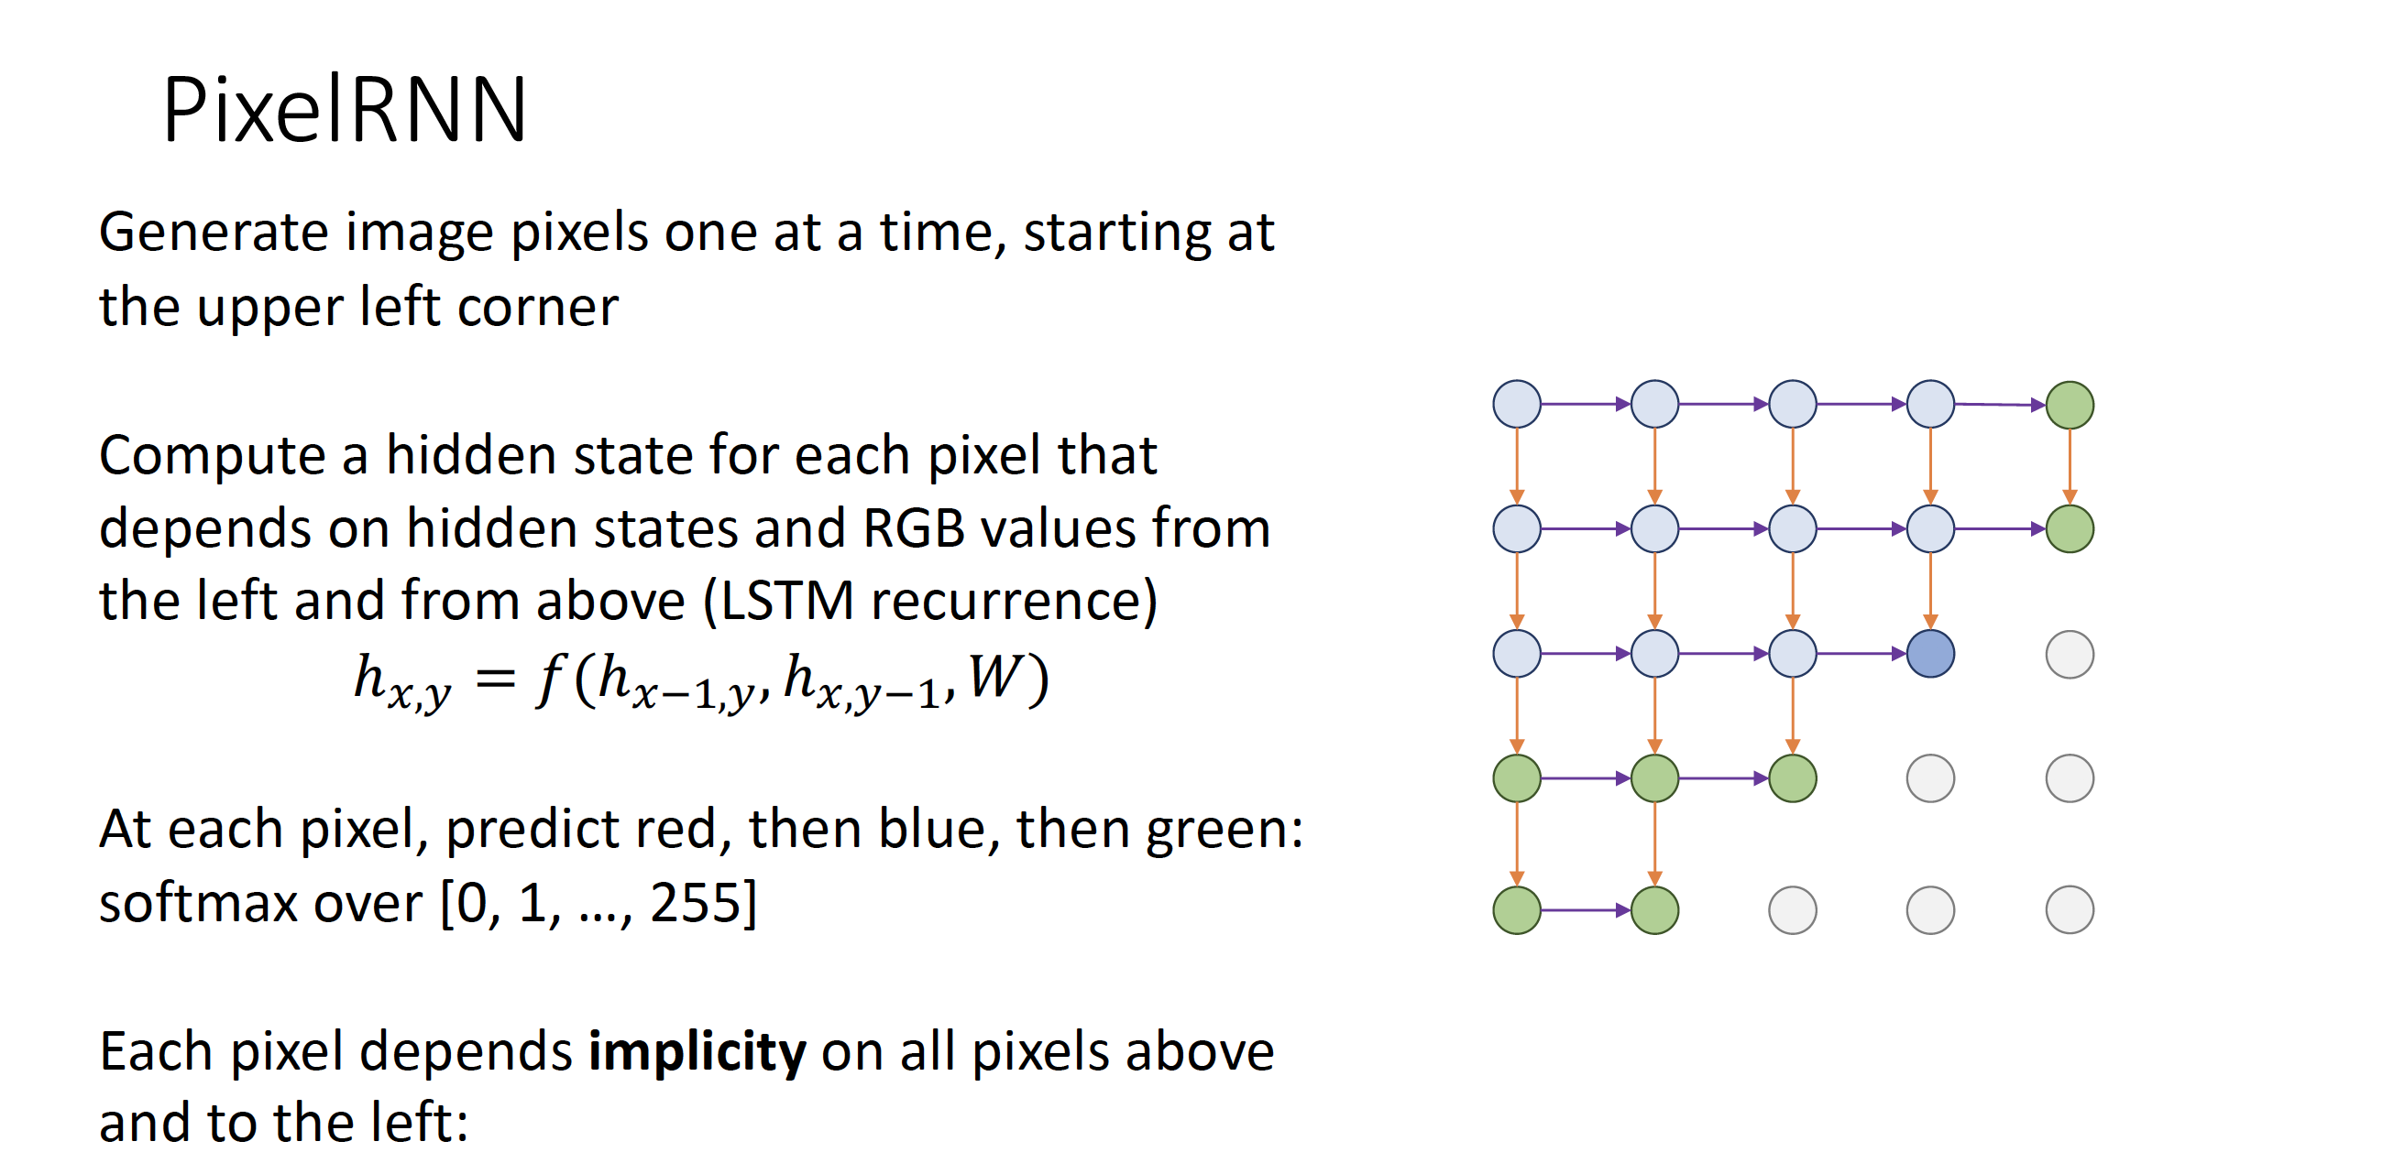

Slide 41
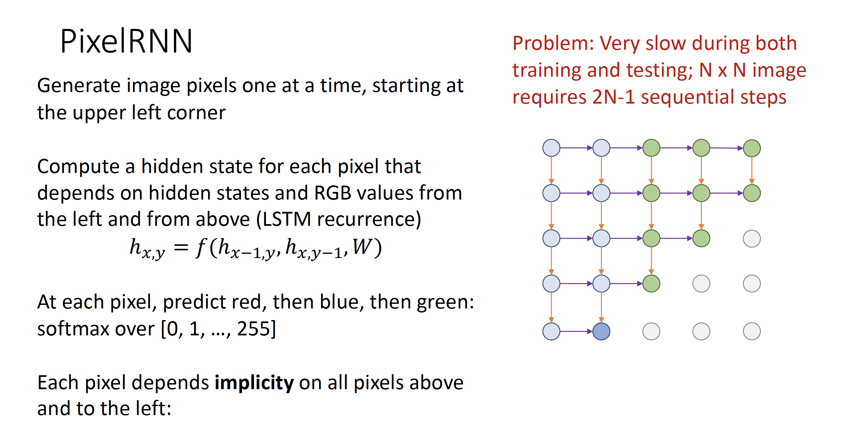

Slide 42
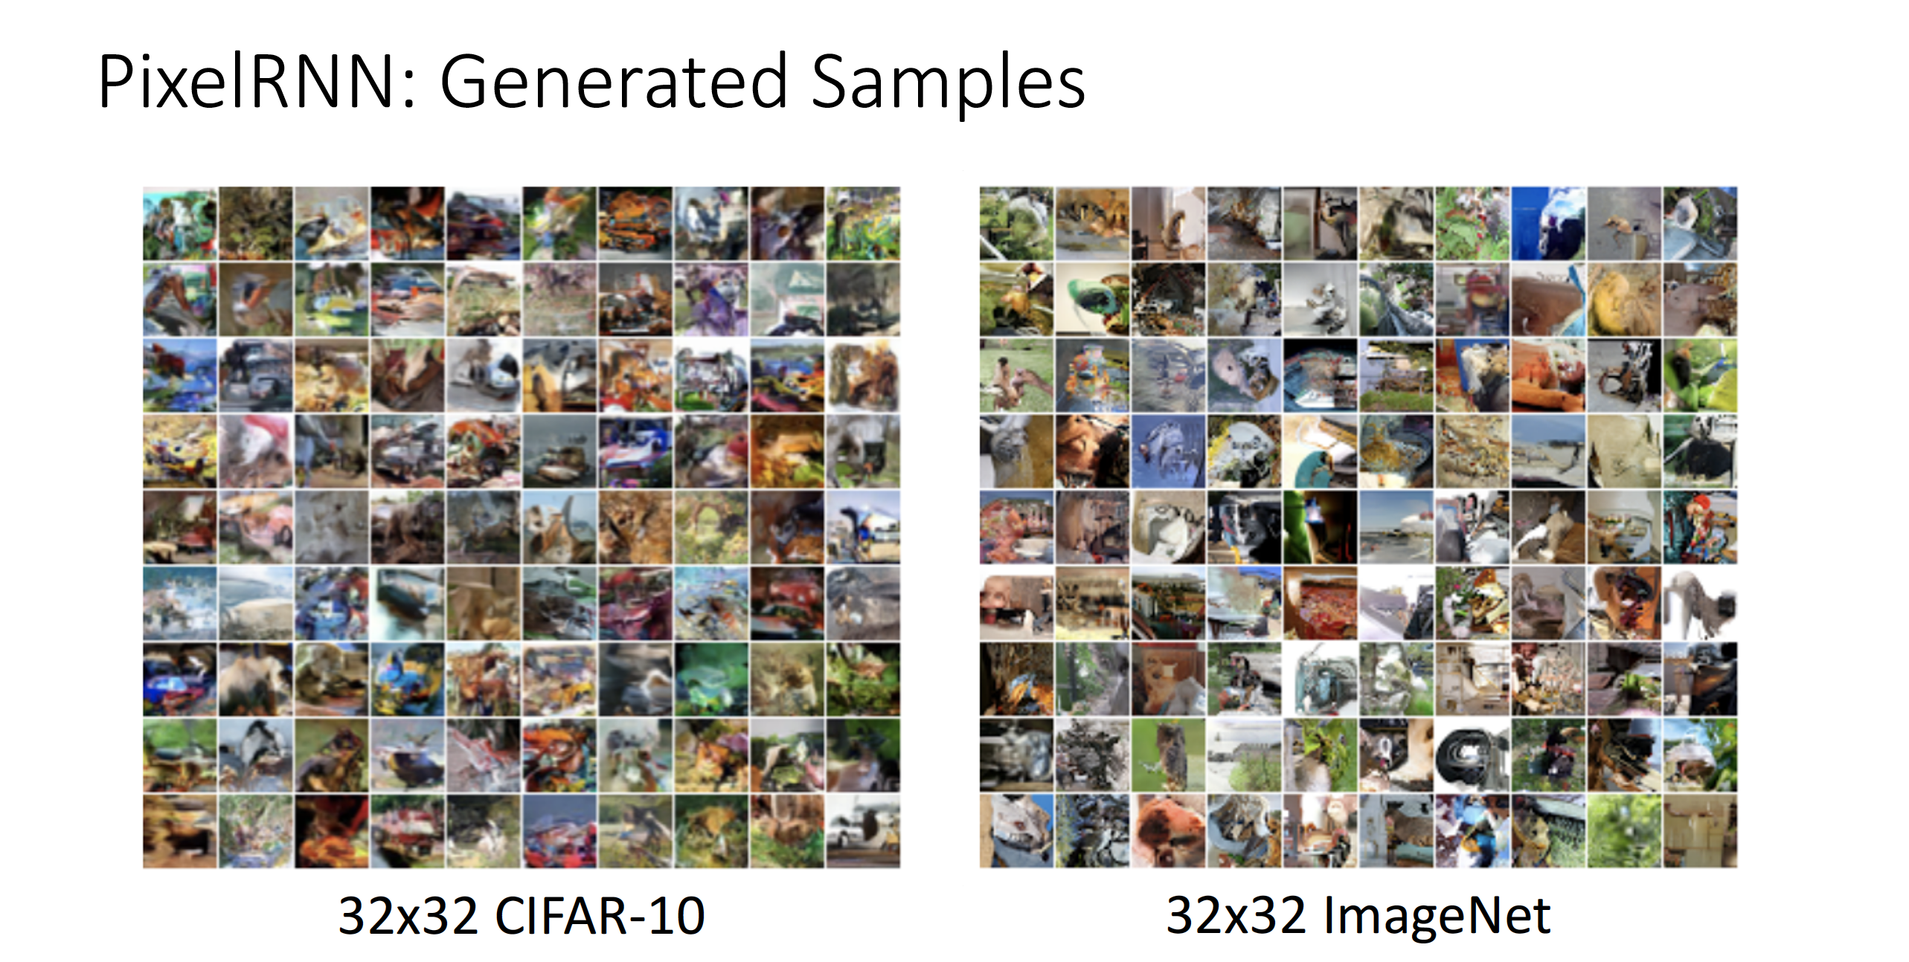

Slide 43
Autoencoders

Slide 44
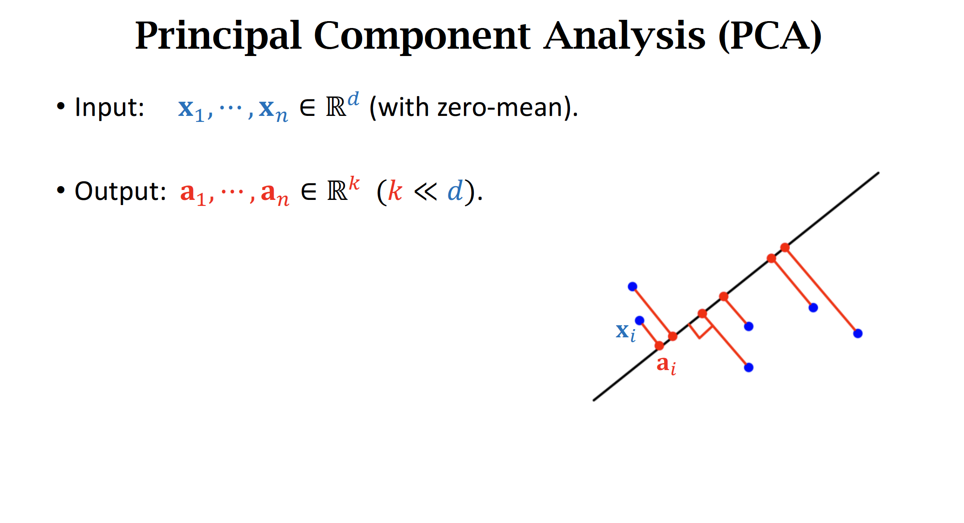

Slide 45
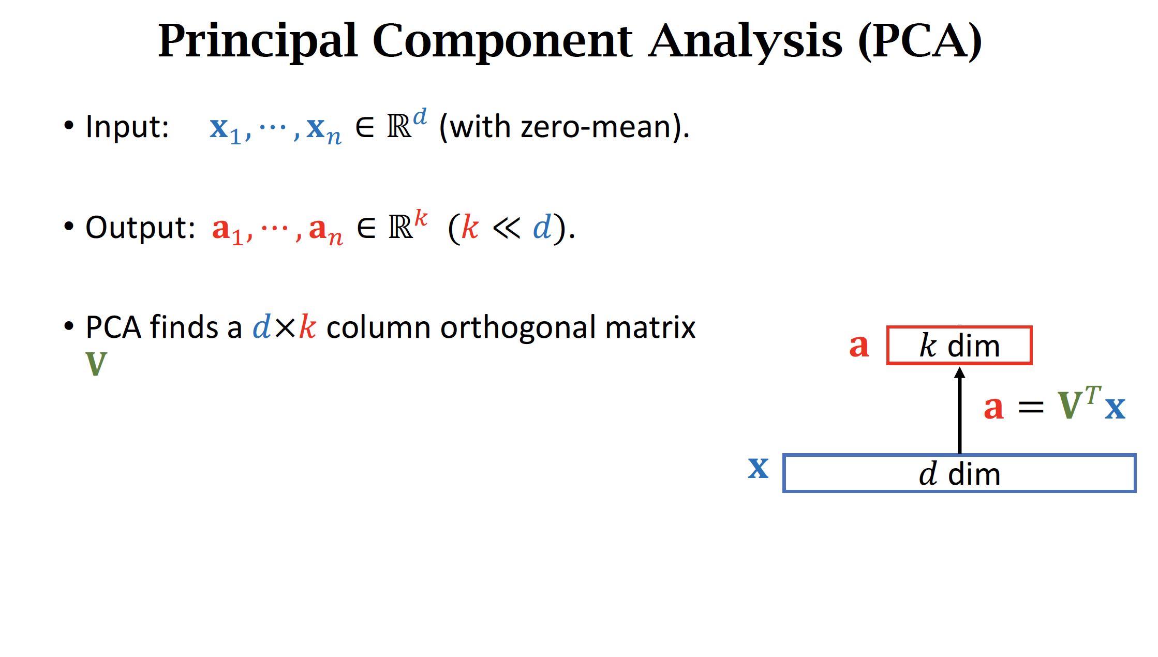

Slide 46
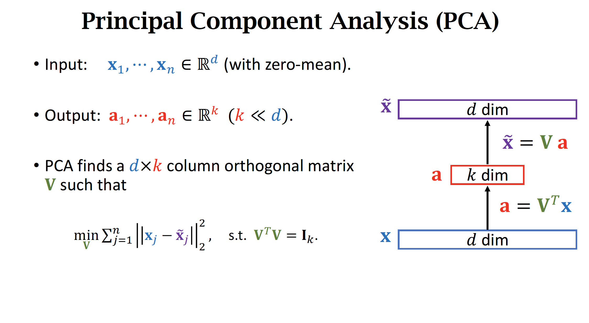

Slide 47
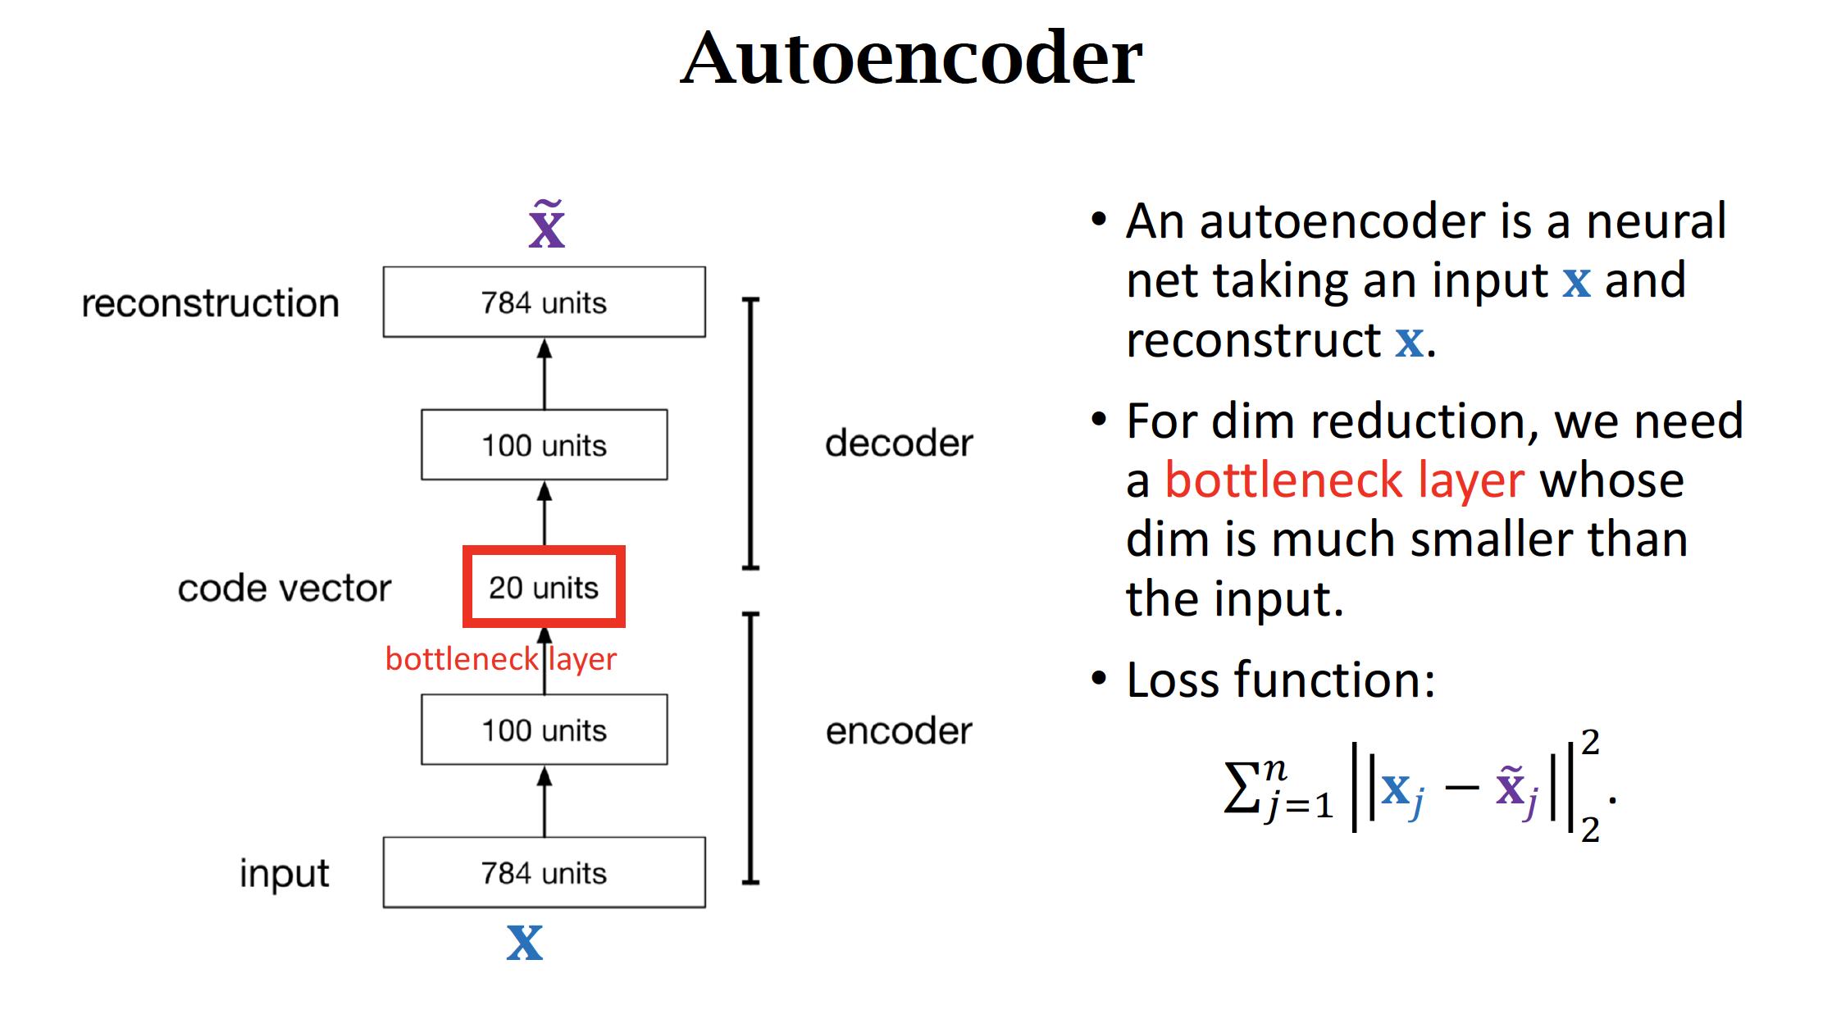

Slide 48
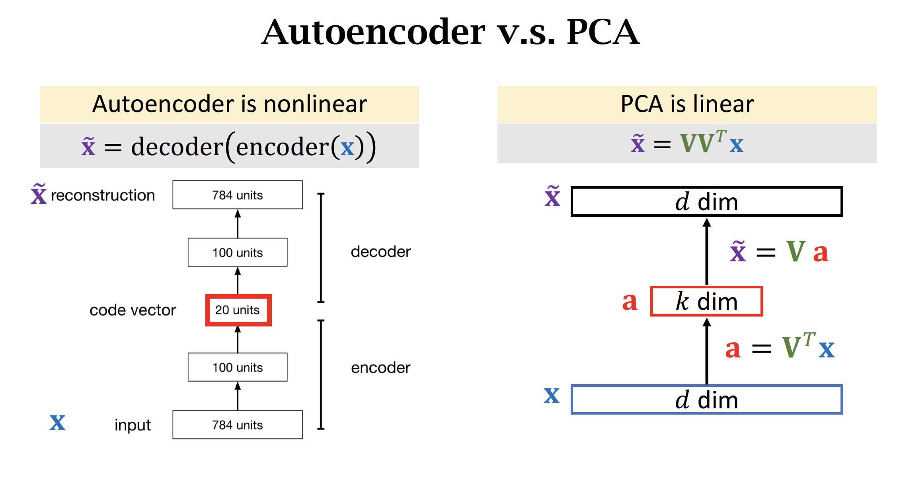

Slide 49
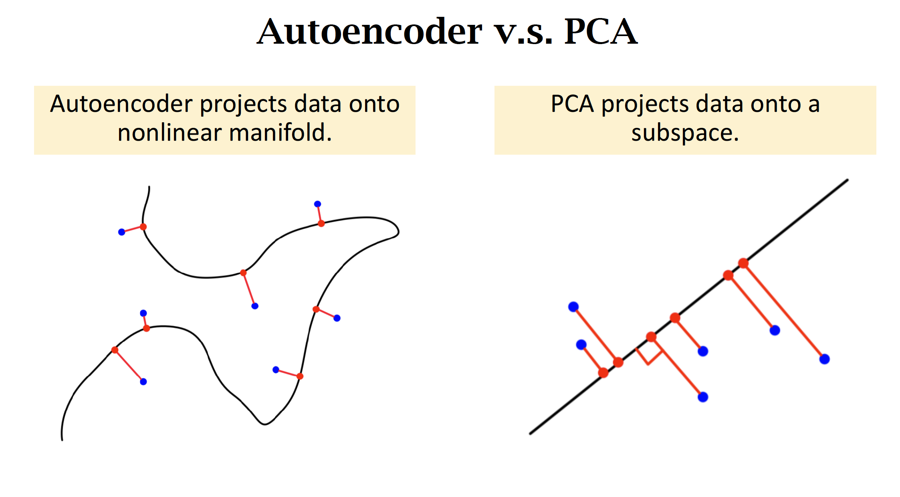

Slide 50
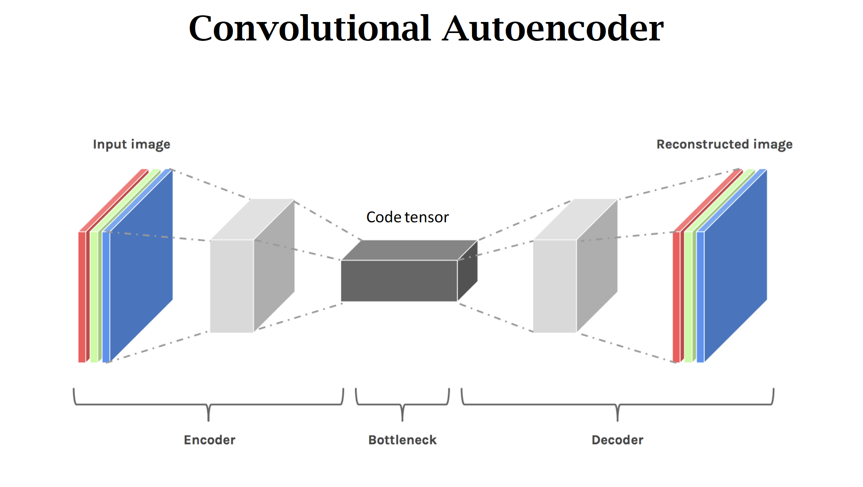

Slide 51
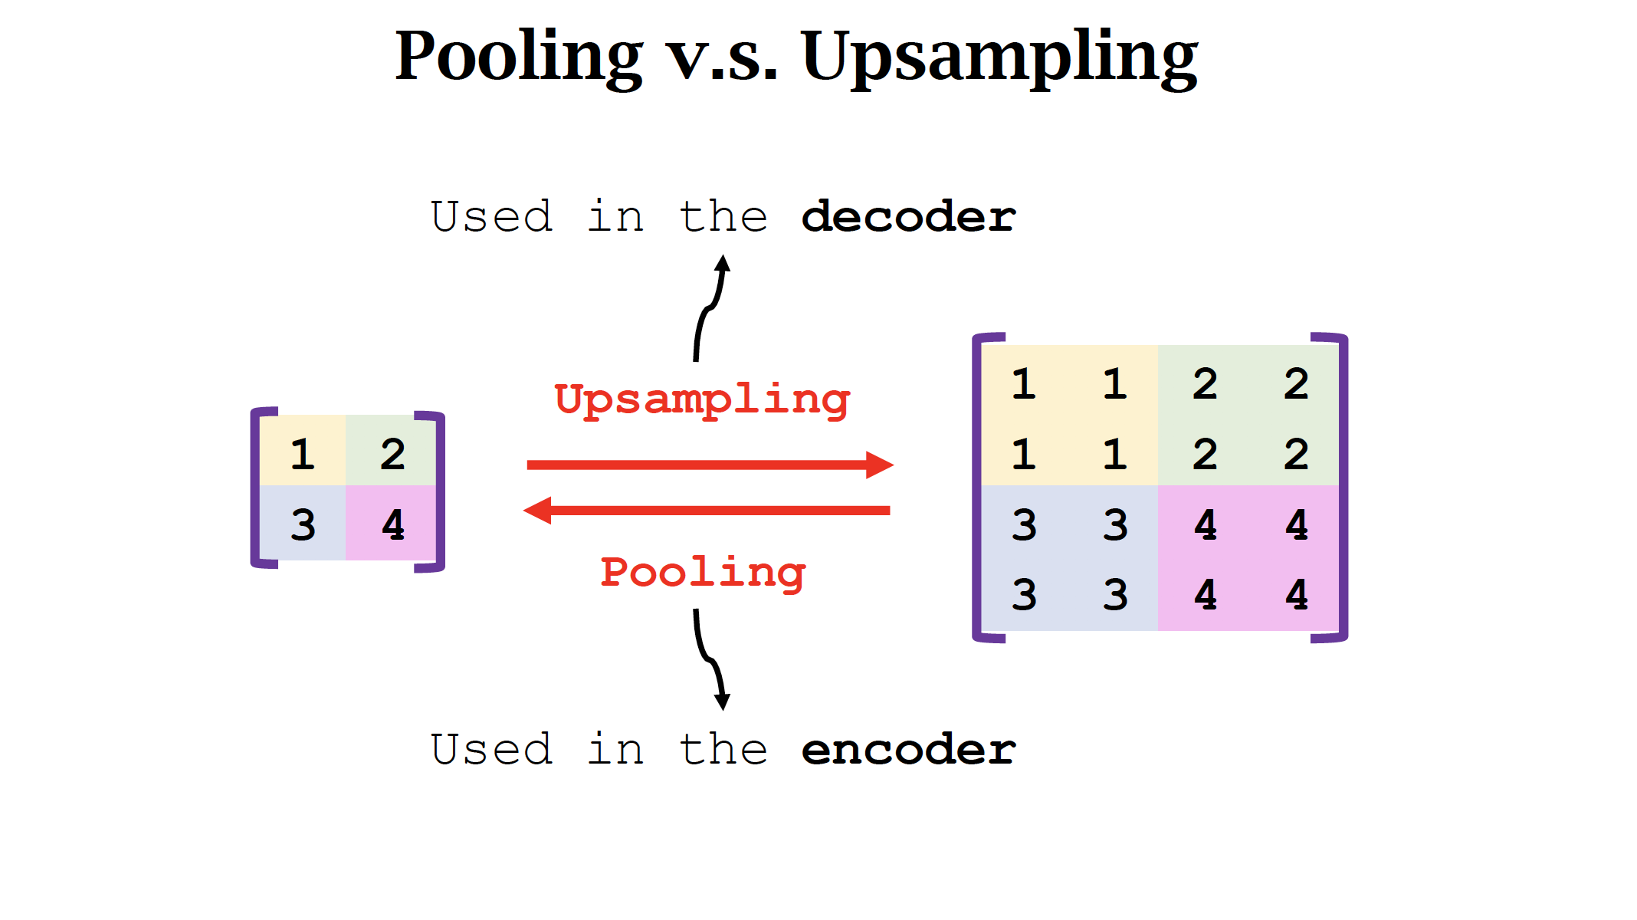

Slide 52
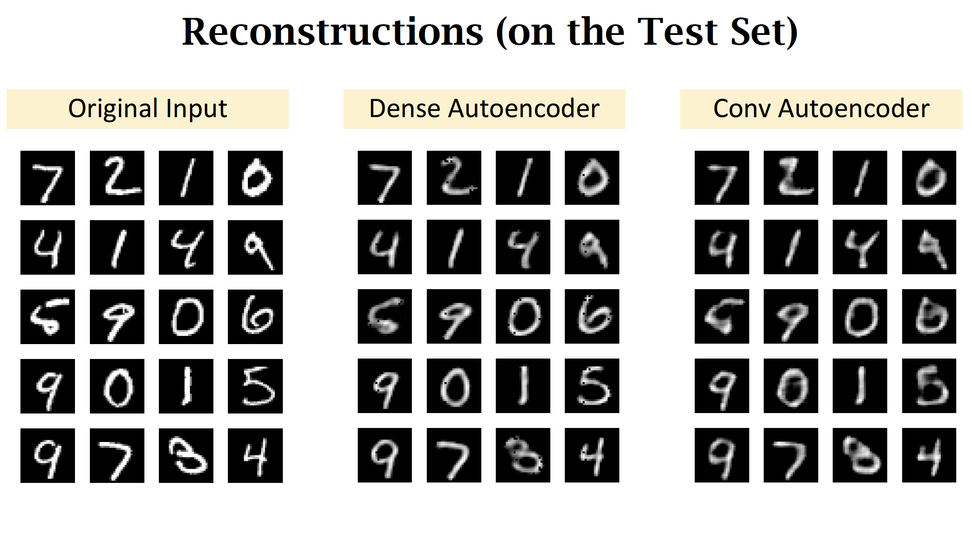

Slide 53
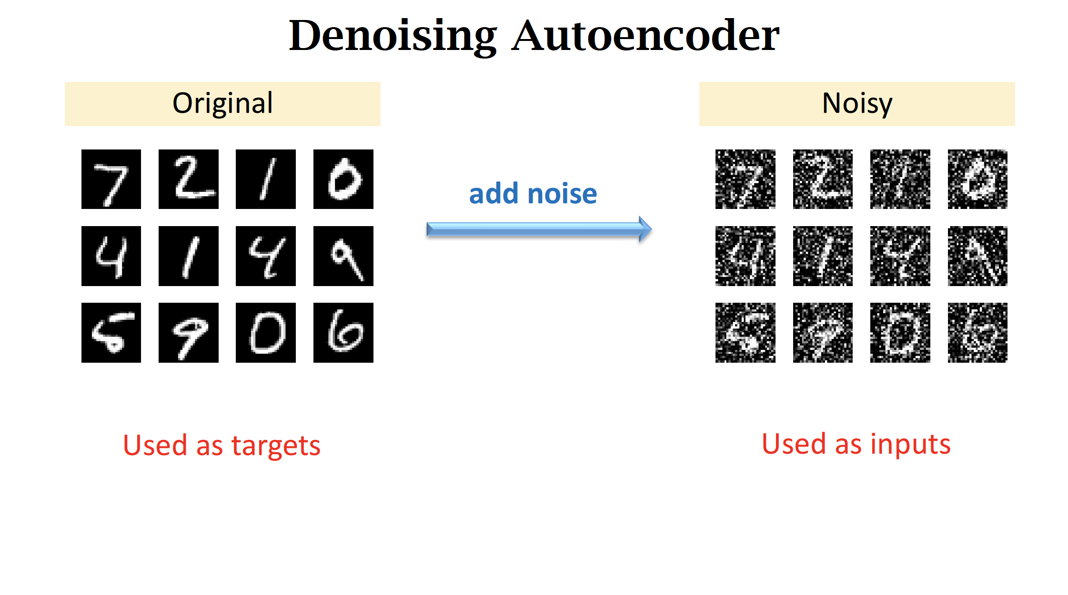

Slide 54
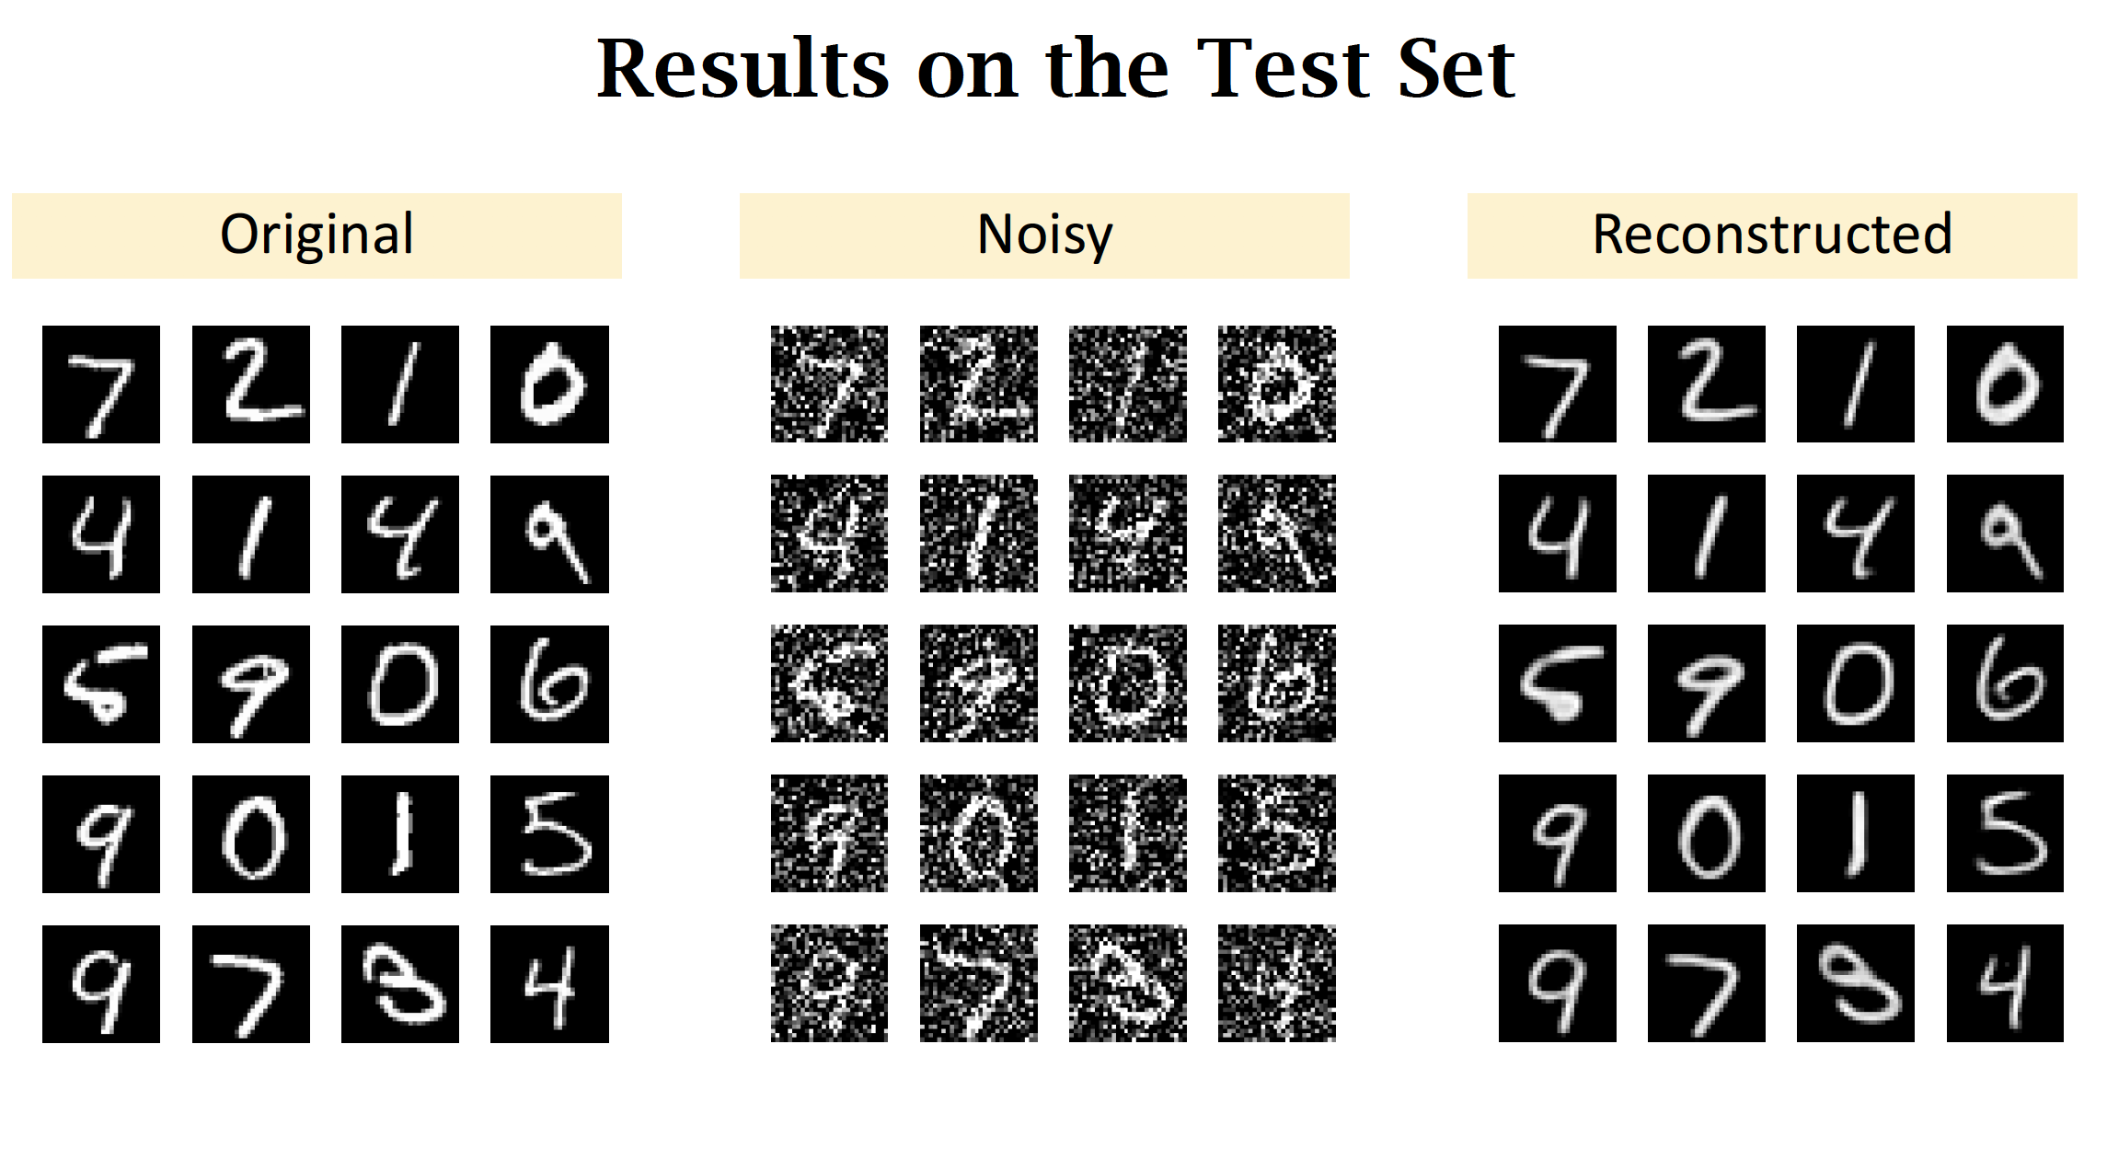

Slide 55
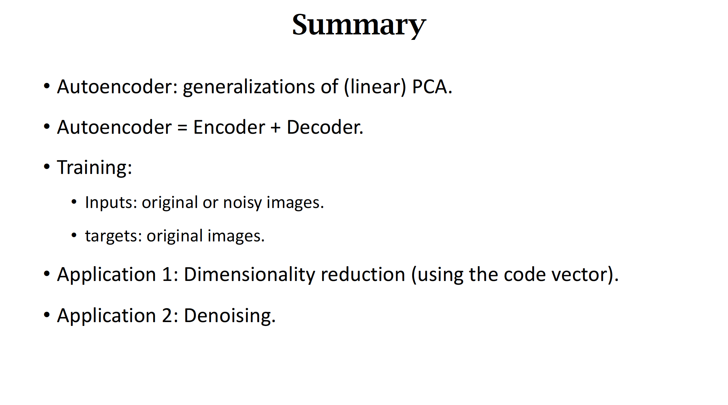

Slide 56
Variational Autoencoders

Slide 57


Slide 58


Slide 59


Slide 60


Slide 61


Slide 62


Slide 63


Slide 64


Slide 65


Slide 66


Slide 67


Slide 68


Slide 69


Slide 70


Slide 71


Slide 72


Slide 73


Slide 74


Slide 75


Slide 76


Slide 77


Slide 78


Slide 79


Slide 80


Slide 81


Slide 82


Slide 83


Slide 84
Any Question ?

